Slide 2
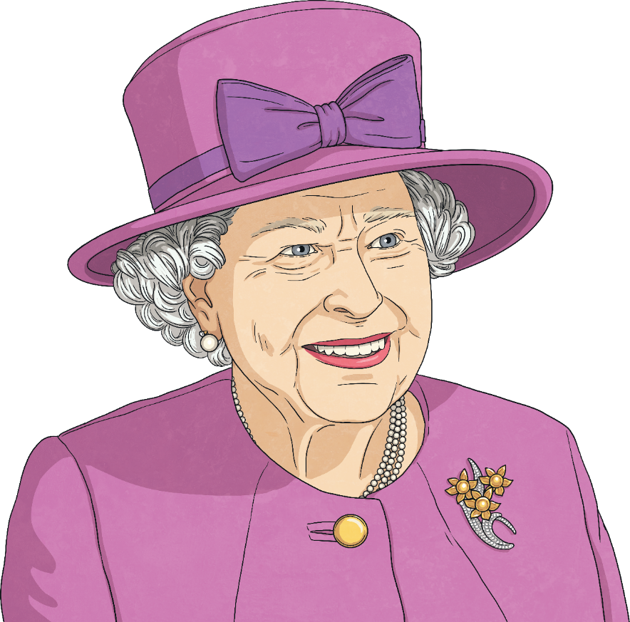
What Is the Queen’s Platinum Jubilee?
2022 marks the 70th year of Her Majesty Queen Elizabeth II becoming the Queen of the United Kingdom, Northern Ireland and the Commonwealth, the first British monarch to reach this milestone.
Throughout the year, there will be numerous celebrations to mark this momentous occasion.
There will be a special Bank Holiday weekend from 2nd June – 5th June to mark the occasion, and this is when the majority of events will happen.
Commonwealth, the first British monarch to reach this milestone.

Slide 3
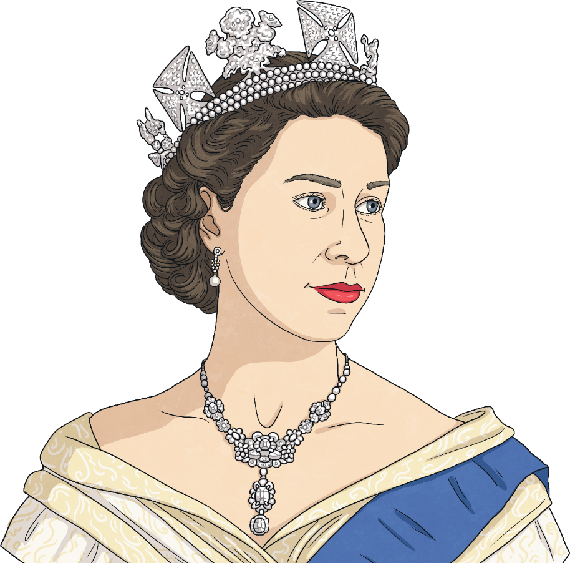
The Queen’s Accession
Queen Elizabeth II became Queen after the death of her father, King George VI, on 6th February 1952 at the age of 25.
At the time, Elizabeth and Prince Philip were in Kenya on tour. After Philip broke the sad news to her, they returned to the UK immediately.
Queen Elizabeth’s accession to the throne was formally proclaimed in countries around the world.
Her coronation was held on 2nd June 1953 at Westminster Abbey.

Slide 4
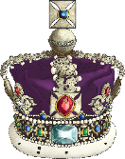
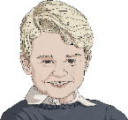
Key Events in the Queen’s Reign
The Queen has presided over numerous key events over her 70 year reign.
Some of these include:
Visits to over 100 countries
14 Prime Ministers of the UK
Becoming the oldest and longest-reigning monarch in British history
The birth of 8 grandchildren and 12 great-grandchildren

Slide 5
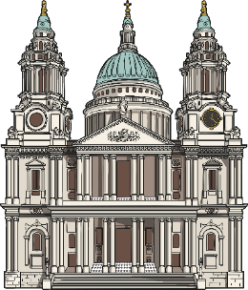
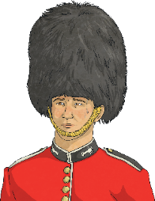
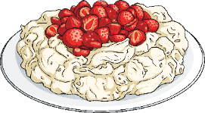
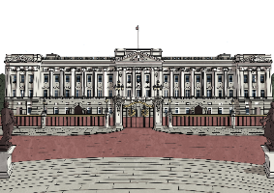
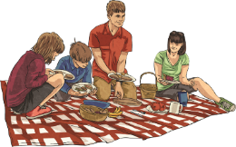
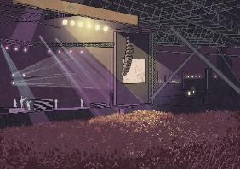
The Platinum Jubilee
Continue
To celebrate the occasion of the Queen’s Platinum Jubilee, there are a wide range of events happening throughout the year.
Click on an event to find out more.
Pudding Competition
Service of Thanksgiving
Beacons
Parade
The Derby at Epsom Downs
Party at the Palace
Big Jubilee Lunch
Jubilee Pageant

Slide 6
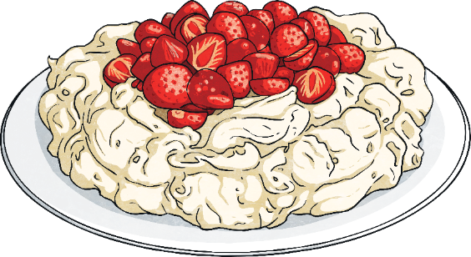
The Platinum Pudding Competition
The Platinum Pudding Competition is a nationwide competition to find a new pudding that will be dedicated to The Queen.
People aged 8 and over can submit their recipe and finalists will be invited to create their pudding in front of a panel of judges.
The winning recipe will be selected and be made available to the public to be enjoyed during the Jubilee celebrations.
Back

Slide 7
The Platinum Jubilee Beacons
Lighting of beacons has been a tradition for previous Jubilees, royal weddings and coronations.
For the Platinum Jubilee, Commonwealth beacons will be lit in the capital city of every country in the Commonwealth – there will be 54 in total!
There will also be thousands of community beacons lit throughout the UK and its overseas territories by charities, communities and other groups.
A special principal beacon will be lit in a special ceremony at Buckingham Palace on 2nd June.
Back

Slide 8
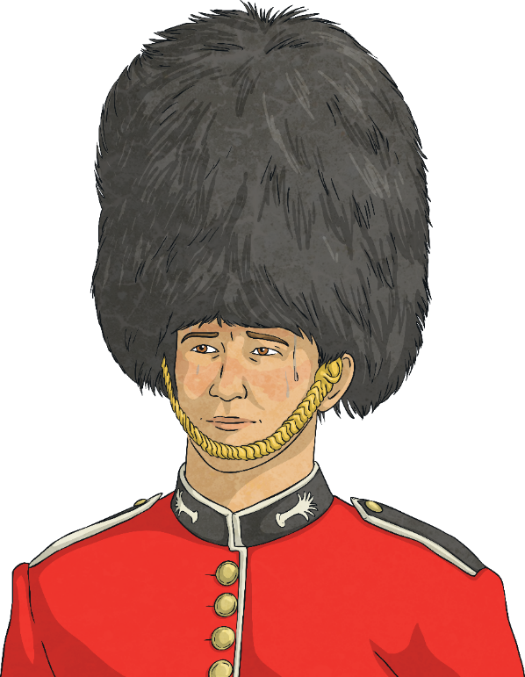
The Queen’s Birthday Parade (Trooping the Colour)
On 2nd June, 1400 parading soldiers, 200 horses and 400 musicians will parade through parts of London to mark the Queen’s official birthday.
The parade will begin at Buckingham Palace, travel down the Mall and end at Horse Guards Parade, with members of the Royal Family travelling in carriages.
There will also be a fly-past by the Royal Air Force, which The Queen and members of the Royal Family will watch from the balcony of Buckingham Palace.
Back

Slide 9
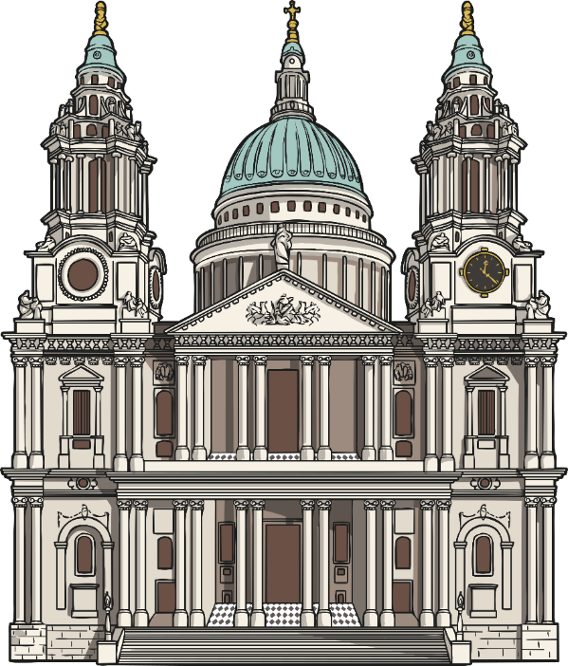
Service of Thanksgiving
On Friday 3rd June, a special service will be held giving thanks for The Queen’s 70 years of service.
It will be held at St Paul’s Cathedral in London and will be attended by The Queen, members of the Royal Family and invited guests. It will also be broadcast on the television for members of the public to watch.
Back

Slide 10
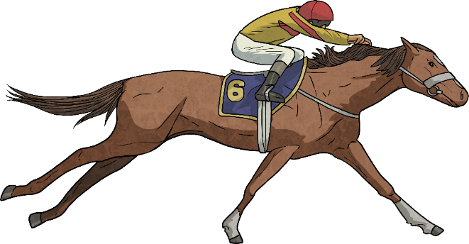
The Epsom Derby
On Saturday 4th June, The Queen and members of the Royal Family will attend The Derby at Epsom Downs.
The Queen is a fan of horse racing and owns more than 100 of her own horses.
Did You Know…?
The Queen’s racehorses have won more than 1600 races!
Back

Slide 11
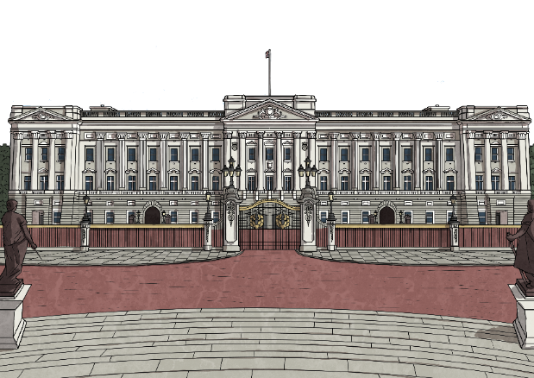
The Platinum Party at the Palace
On Saturday 4th June, there will be a special concert at Buckingham Palace that will have some of the biggest names in entertainment.
Members of the public who have won a ballot for tickets will be in attendance, as well as special guests including members of the Royal Family.
It will be broadcast live on television for members of the public to enjoy.
Back

Slide 12
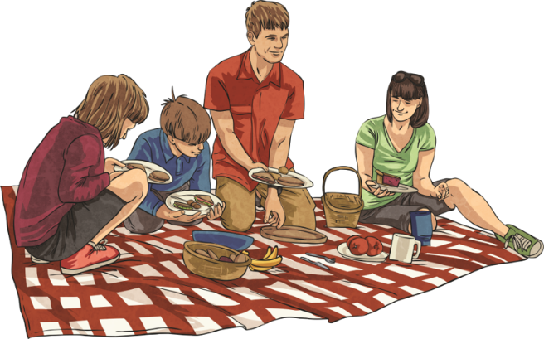
The Big Jubilee Lunch
On Sunday 5th June, people are invited to join together to share a special lunch to celebrate the Platinum Jubilee.
The Big Lunch has been an annual event since 2009, but this year has joined with the Jubilee to encourage people to have gatherings – big or small – and celebrate community and friendship.
People may be having picnics, street parties, tea and cake or barbeques.
Back

Slide 13
The Platinum Jubilee Pageant
On Sunday 5th June, a wide range of performers, dancers, musicians, key workers, members of the military and volunteers will form a parade that will tell the story of The Queen’s 70 year reign.
There will be street art, theatre, music, circus performances, costumes and amazing visuals and the people involved will be from the UK and countries all across the Commonwealth.
There will also be a special procession of 200 silk flags along The Mall called ‘River of Hope’. Each flag will have a design created by schools and they will display messages about climate change and hopes for the future.
Back

Slide 14
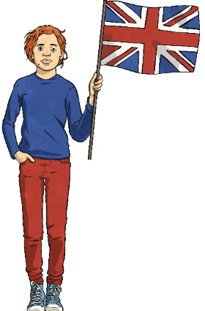
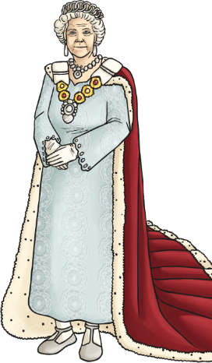
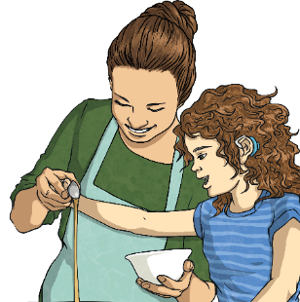
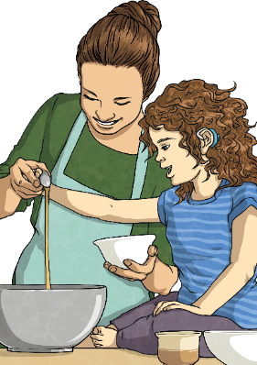
How You Can Celebrate
So, how can you join in to celebrate the Platinum Jubilee?
Here are a few ideas:
Plant a tree as part of the ‘Queen’s Green Canopy’ project
Make some special Jubilee decorations
Find out about some of the amazing events in The Queen’s life
Bake something to share with friends and family

