Slide 1
Creation and science: conflicting or complementary?
Creation/Fall – RE Lesson 5
Notes:
Flip chart and postit notes – pre topic assessment – thoughts
Take picture of answers to stick in books

Slide 2
Learning objectives Identify key ideas arising from the study of Genesis 1 and be able to comment on how far these are helpful or inspiring, justifying their responses.

Slide 3
Steps to Success
Pupils can recognise how Genesis 1 inspires Christians to care for the Earth and worship God.
Pupils can arrange statements on a continuum: between what all Christians believe and no Christians believe.
Pupils are able to justify why they have chosen to place statements in their positions.
Blooms
Remember
Analyse
Evaluate

Slide 4
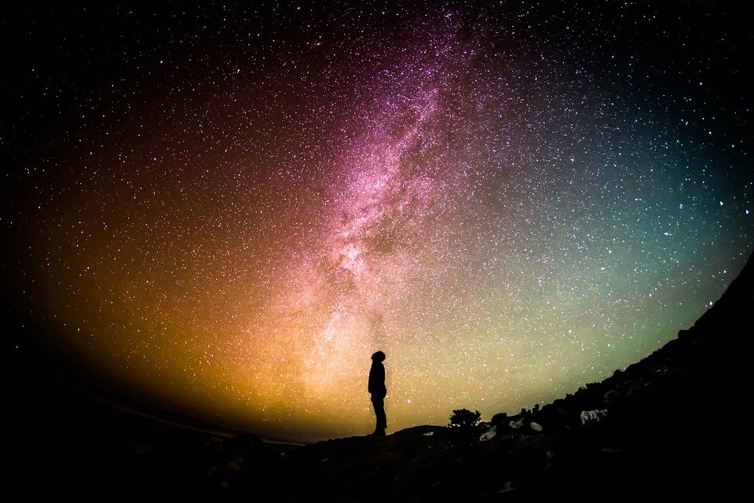
Home learning - Gaze up at the night sky and write down your feelings and sensations.

Slide 5
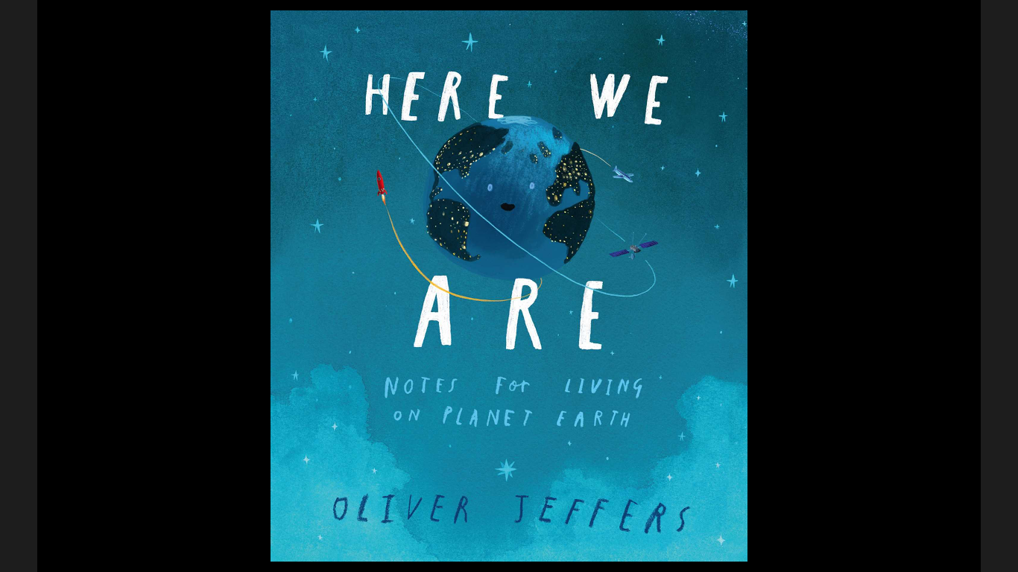

Slide 6
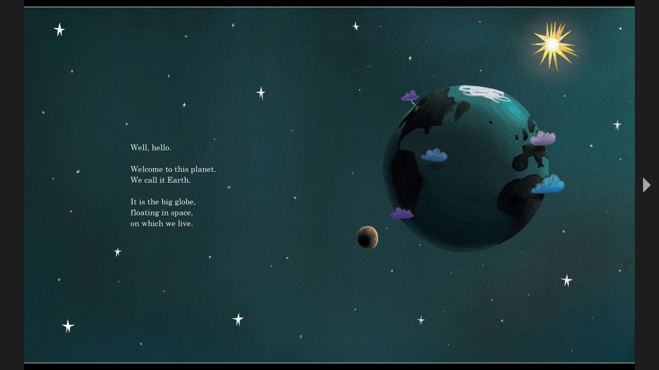

Slide 7
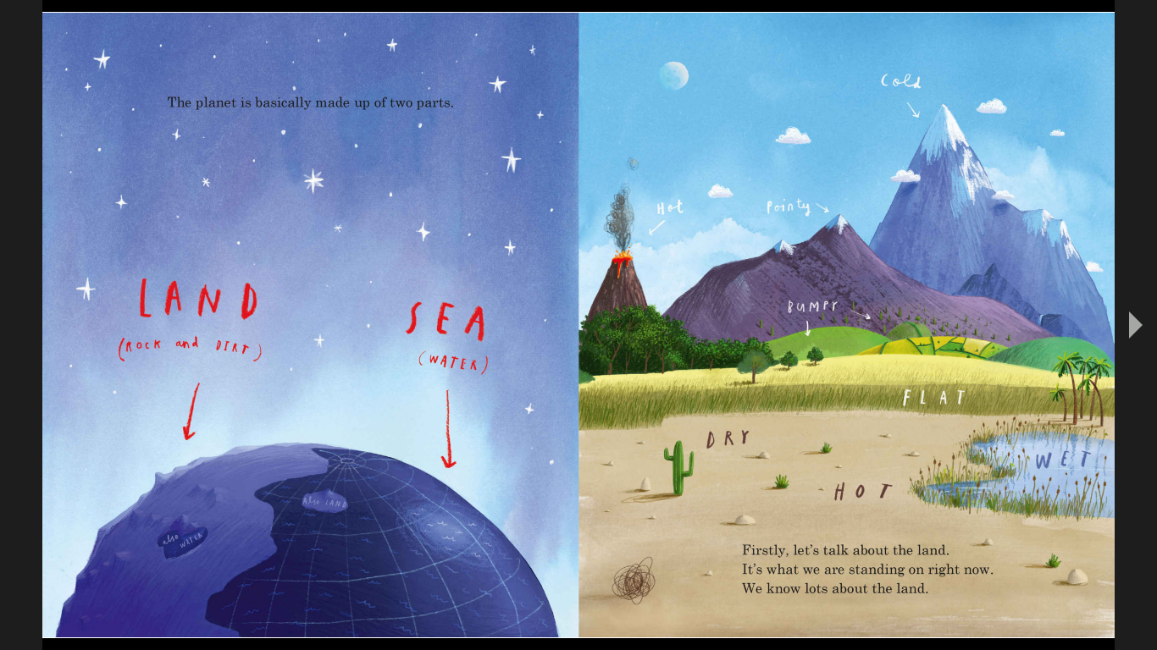

Slide 8
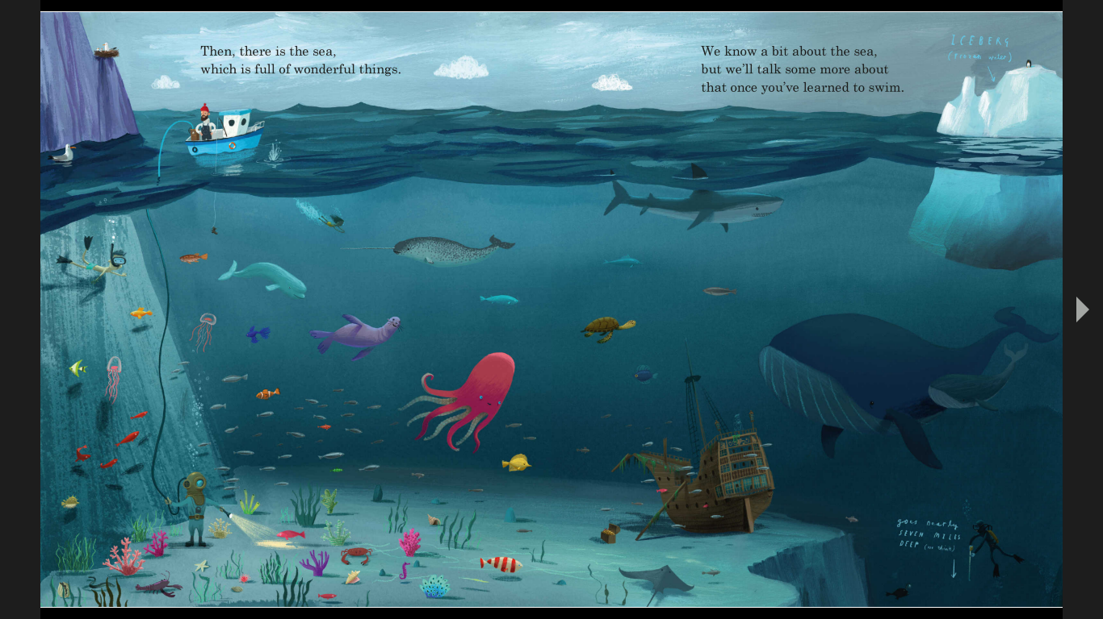

Slide 9
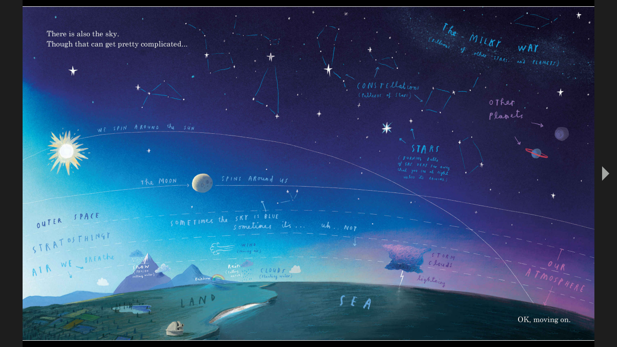

Slide 10
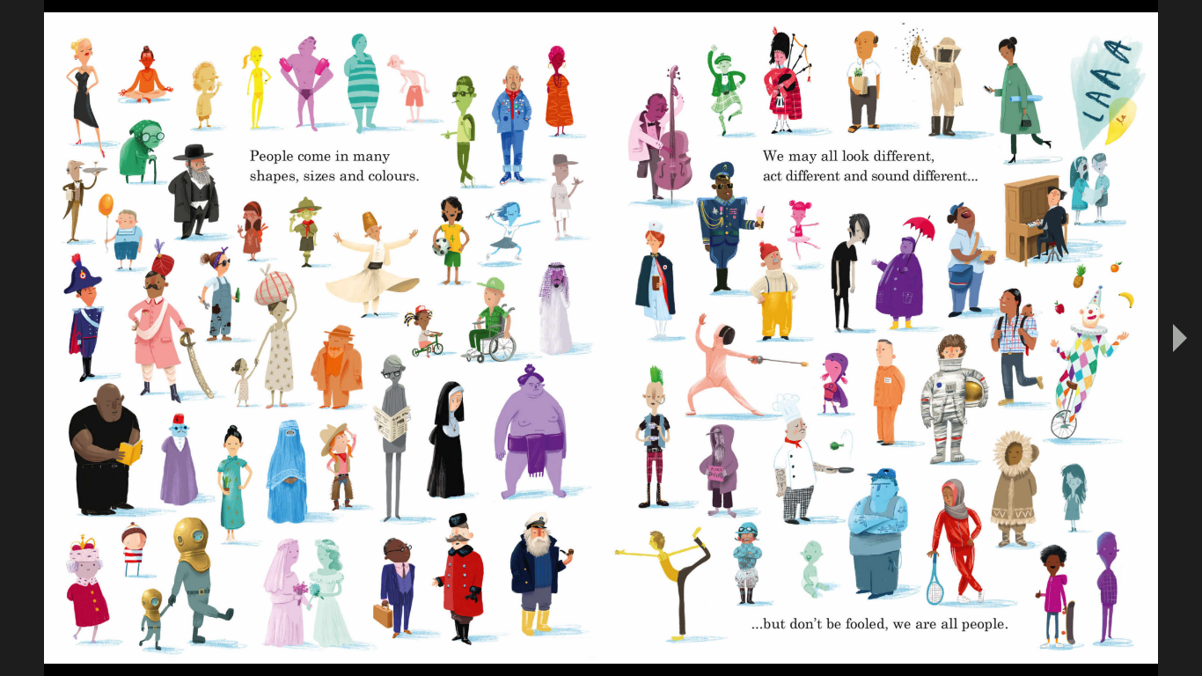

Slide 11
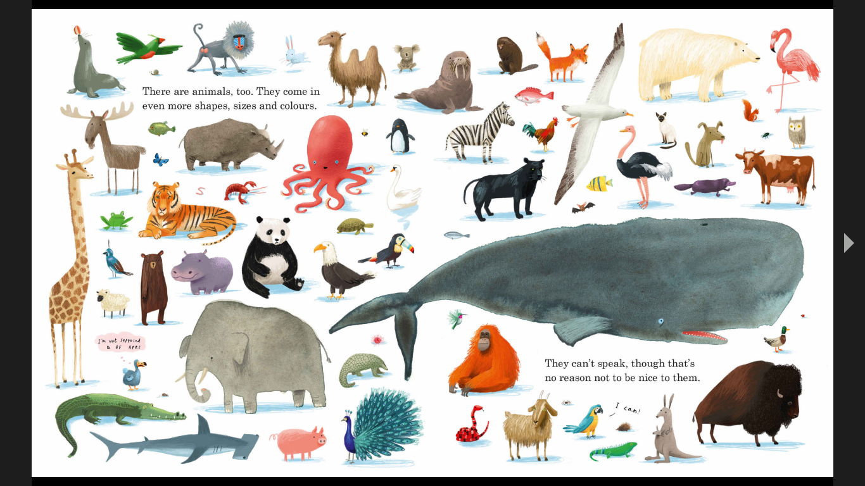

Slide 12
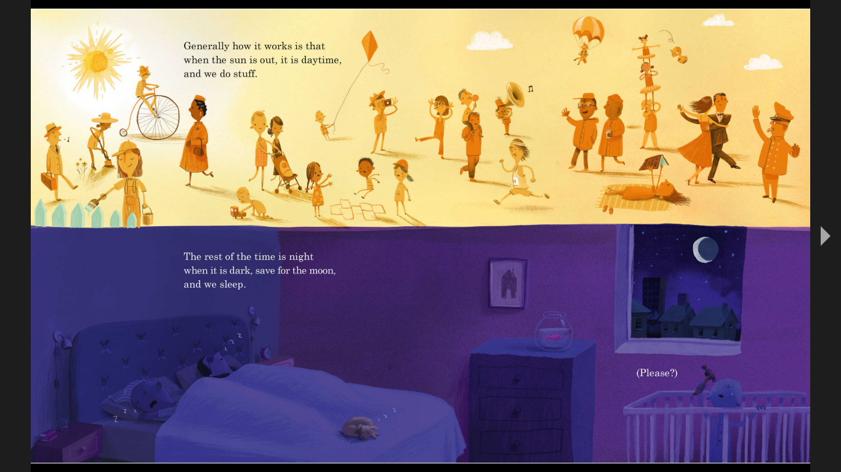

Slide 15
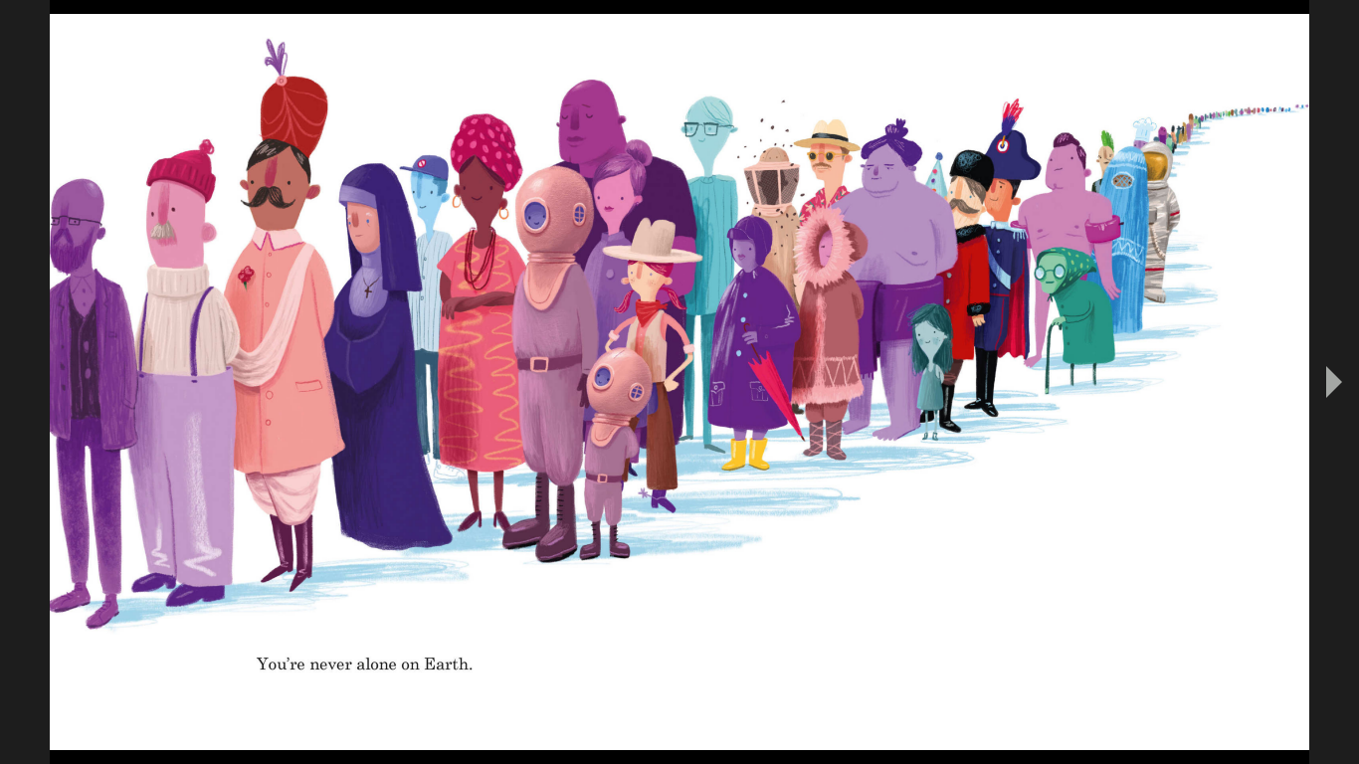

Slide 16
What were the key points of the book?

Slide 17
What were the key points of the book?
Did the book link to Genesis 1 at all?

Slide 18
What were the key points of the book?
Did the book link to Genesis 1 at all?
Did you find it inspirational?

Slide 19
What were the key points of the book?
Did the book link to Genesis 1 at all?
Did you find it inspirational?
Who was the target audience for the book?

Slide 20
What were the key points of the book?
Did the book link to Genesis 1 at all?
Did you find it inspirational?
Who was the target audience for the book?
Who was the target audience for Genesis 1?

Slide 21
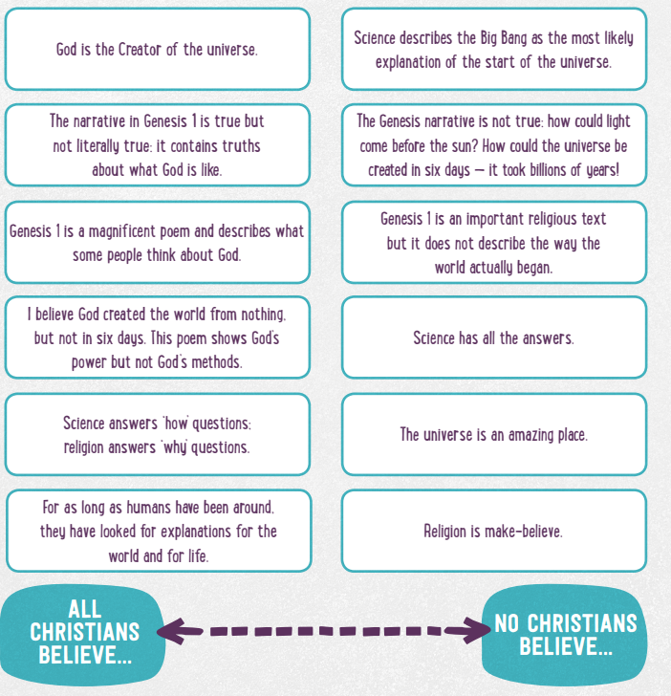
Sort the statements Draw a continuum line: from All Christians believe... to No Christians believe... Place the statements on the line. There are few definite answers for this, but you need to be able to explain your reasons for where you’ve placed them on the line.

Slide 22
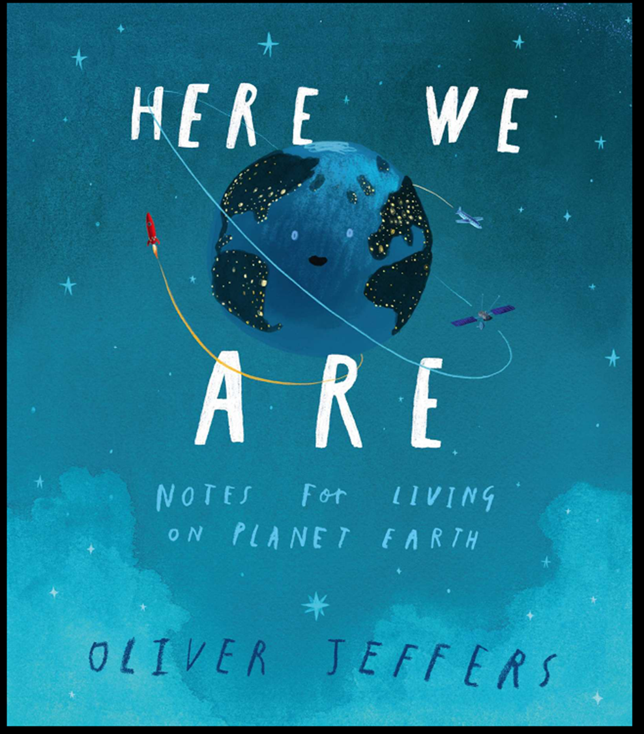
How often do you stop an wonder how amazing the world is?
If you find any book/art/photo of the world that makes you inspired please bring it next lesson.

Slide 23
What and how did you learn?
What I have learnt today? - One sentence or phrase
How I felt about my learning:
Red – low understanding
Orange – understood some but not all
Green – understood all
A question related to the lesson – optional

