Slide 1
Story part 2 –
The Temptation of Jesus

Slide 2
The Temptation of Jesus
Have you ever been tempted to do or say something that you know is wrong?
For example, you knew you had homework that needed to be done, or a job to do for someone, but your favourite programme was on TV, so you chose to watch TV instead. When you’re asked about it, did you make an excuse?
It isn't wrong to be tempted – it’s acting on it that can be wrong.
Even Jesus was tempted and in the next part of our story, we hear all about it…

Slide 3
Click below to hear the story…
This video is copyright protected. We have permission as a Diocese to use it in our schools for this resource

Slide 4
If you would also like to read it, this is from Luke’s gospel. Option to listen
Luke - Chapter 4
Jesus returned from the Jordan River and was led into the desert. There the devil tempted him for 40 days. Jesus ate nothing during this time, and when it was finished, he was very hungry. The devil said to him, “If you are the Son of God, tell this rock to become bread.” Jesus answered, “It is not just bread that keeps people alive.’”
Then the devil took Jesus and showed him all the kingdoms of the world. The devil said to him, “I will make you king over all these places. You will have power over them and get all the glory… I will give it all to you, if you worship me.” Jesus answered, “You must worship the Lord your God and serve only him.’”
Then the devil led Jesus to Jerusalem and put him on a high place. He said to him, “If you are the Son of God, jump off! The Scriptures say, ‘God will command his angels to take care of you.”
Jesus answered, “But the Scriptures also say, ‘You must not test the Lord your God.’
The devil finished tempting Jesus in every way and went away to wait until a better time.

Slide 5
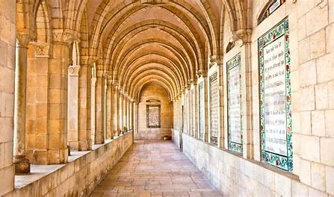
When we looked at Jesus being baptised, we looked at The Lord’s Prayer.
You may want to say it again today as you think about temptation.
Our Father in heaven, hallowed be your name, your kingdom come, your will be done, on earth as in heaven. Give us today our daily bread. Forgive us our sins as we forgive those who sin against us. Lead us not into temptation but deliver us from evil. For the kingdom, the power, and the glory are yours now and for ever. Amen.
This is a picture of the Church of the Pater Noster in Israel. (Pater Noster means ‘Our Father’ in Latin).
In and around the Church the Lord’s Prayer is written on tiles in 140 languages. A different one is prayed each day.

Slide 6
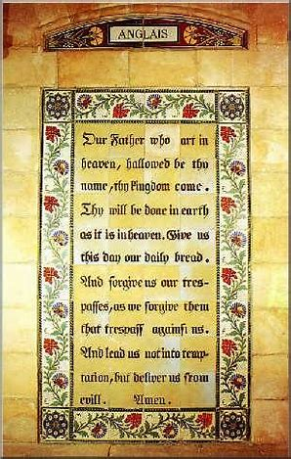
Putting the story into action…
Jesus was tempted but he found ways to stop himself giving in. Make a decision to try a new skill. When it’s hard and you feel like giving up…keep going a bit longer!
or
This is the English tile from the Church of the Pater Noster in Israel. Design a new tile for the modern version of the Lord’s Prayer that is often used in churches today.

Slide 7
This resource was produced by the Diocese of Leeds Education Team. For more information about this or future resources,
please contact your named adviser:
simone.bennett@leeds.anglican.org
simon.sloan@leeds.anglican.org
darren.dudman@leeds.anglican.org
janet.tringham@leeds.anglican.org
lee.talbot@leeds.anglican.org
rupert.madeley@leeds.anglican.org

