Slide 1
An Introduction

Slide 2
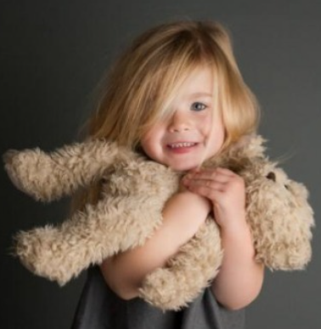
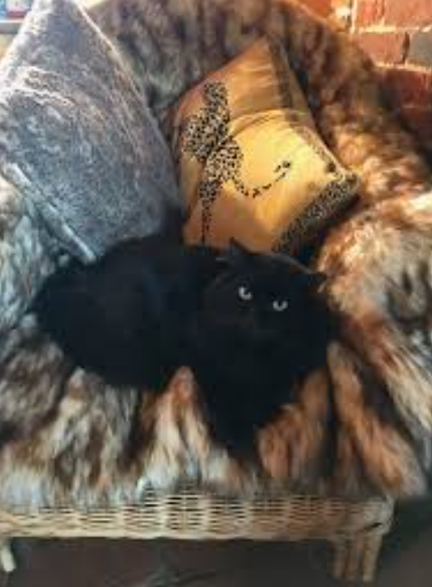
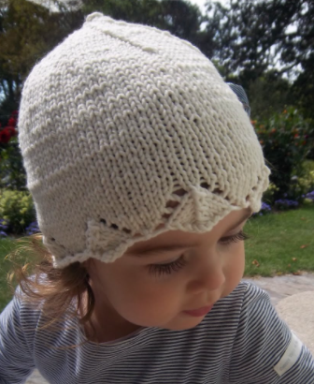
Do you have a thing that is your favourite thing?
What is it?
A favourite hat?
A favourite toy?
A favourite chair?
A favourite book?

Slide 3
Often favourite things are special because we are so familiar with them. We know them so well.
Our habits are ways of behaving which are very familiar to us. Often they are so familiar we do them automatically without thinking.
Before Christmas, you joined us on the Rhythm of Life Advent Journey.
We all became familiar with seven habits that can help us live our lives.
Can you remember all seven?

Slide 4
Match the habit to its icon and say what each one means.
Celebrating
Reflecting
Encouraging
Praying
Sharing
Resting
Creating

Slide 5
Celebrating
These habits can help us to flourish and to learn to understand ourselves and our lives better.
Reflecting
Sharing
Praying
They can also help us to learn more about God and his love for us.
Encouraging
Resting
Once again, over the next few weeks, we are going to learn more about how to live these habits in our daily lives.
Creating

Slide 6
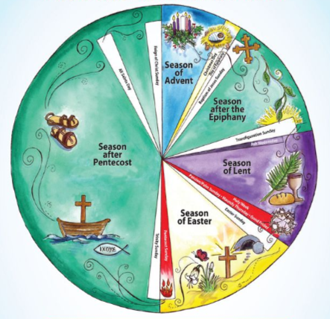
We are no longer in the season of Advent. This is now the Christian season of Lent.
During Lent, Christians prepare for the celebration of Easter, recalling Jesus’ death and resurrection.
But, just like Advent, in Lent the rhythms and habits of our lives can help us.

Slide 7
As the weeks progress, we will also look in the Bible at the story of Jesus’ life. First we will think about his baptism and the time he spent in the wilderness. Then we will think about the events of Holy Week, running up to that first Easter including, of course, Jesus’ death on Good Friday and resurrection on Easter Sunday.
But Lent is not just about listening and thinking. It is not even really about giving something up. Lent is about taking action and learning to live a better life. So on the way, there will be suggestions about what action you can take each day.

Slide 8
Putting things into action!
You might like to try:
What can you remember of the Easter story? Draw a picture of a scene from that story and explain to someone what your picture shows
or
Re-learn the list of our 7 habits and what each one means.

Slide 9
If you would like to, you can join in saying these prayers.
A Prayer for the Day
The Rhythm of Life Prayer
Lord Jesus,
in the days ahead of us
on our Lent journey,
may we travel with excitement
as we prepare to celebrate
the wonders of all you did for us
on the first Easter.
Amen
Loving God,
as we journey through this season,
help us to practice
these seven habits
so that the rhythm of our lives
can bring us closer to each other
and to you.
Amen

Slide 10
This resource was produced by the Diocese of Leeds Education Team. For more information about this or future resources,
please contact your named adviser:
simone.bennett@leeds.anglican.org
simon.sloan@leeds.anglican.org
darren.dudman@leeds.anglican.org
janet.tringham@leeds.anglican.org
lee.talbot@leeds.anglican.org
rupert.madeley@leeds.anglican.org

