Slide 1
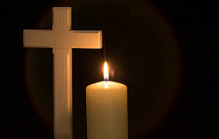
Thursday 11th February
Collective Worship

Slide 2
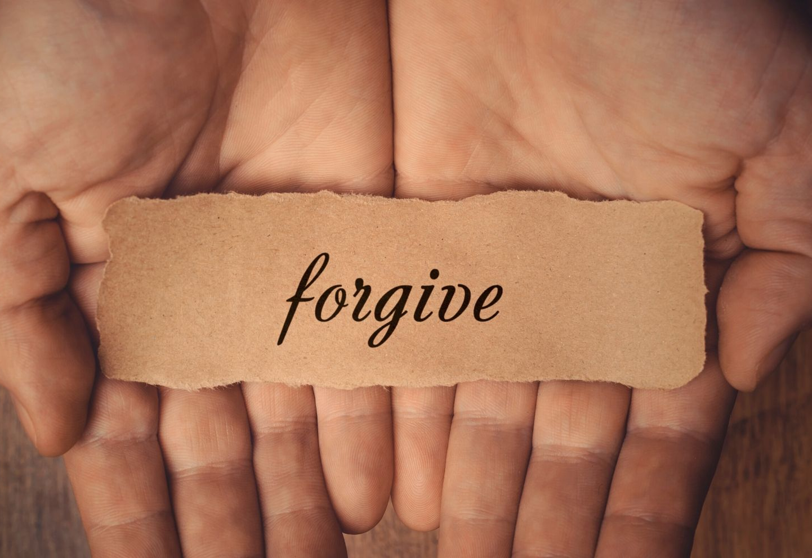
“Just as the Lord has forgiven you, so you must also forgive others.”
Colossians 3.13

Slide 3
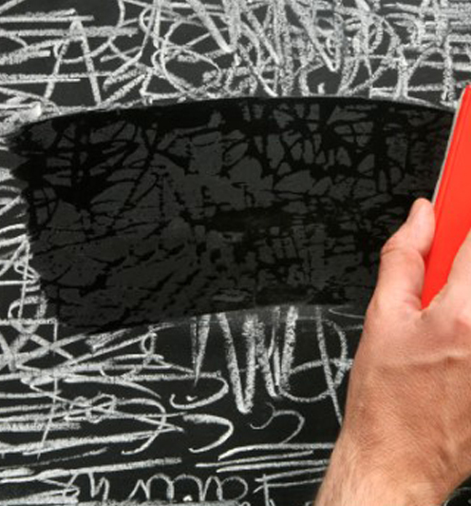
Forgiveness is sometimes described as “wiping the slate clean.”

Slide 4
FORGIVENESS IS….
Forgetting the hurts
Offering a new beginning
Restoring a friendship
Given and received
Identifying responsibility
Valuing the truth
Ending an argument
Not holding a grudge
Encouraging honesty
Saying sorry
Starting again.

Slide 5
Why line do you think describes real forgiveness and why?

Slide 6
Today’s prayer is called a ‘Teaspoon Prayer’. The sentences in the prayer start with Thank you, Sorry and Please (or t,s,p which is the abbreviation for teaspoon)

Slide 7
Dear Lord, Thank you that you offer forgiveness to all, through Jesus. Sorry for the times when we have been slow to say sorry to others or not quick enough to forgive. Please help us to ask for forgiveness when we make a mistake and to accept an apology kindly. Amen

Slide 8
Go in faith, hope and love….
To believe, learn and flourish.

