Slide 1
Sharing

Slide 2
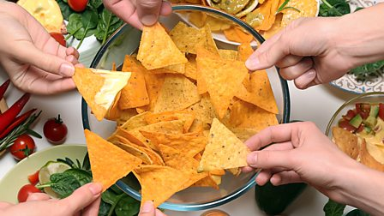
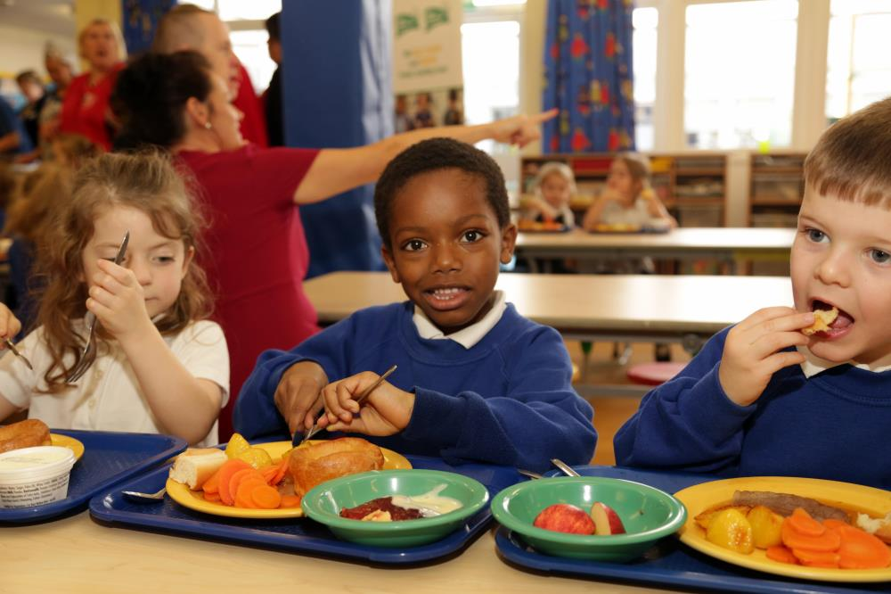
Today, our theme is sharing and we are going to think about something that happened at the last meal with Jesus before he was killed.
Before we start, consider these questions…
When do you share meals with people?
Have you ever shared any
very special meals?
What habits might you or others have before you eat a meal?

Slide 3
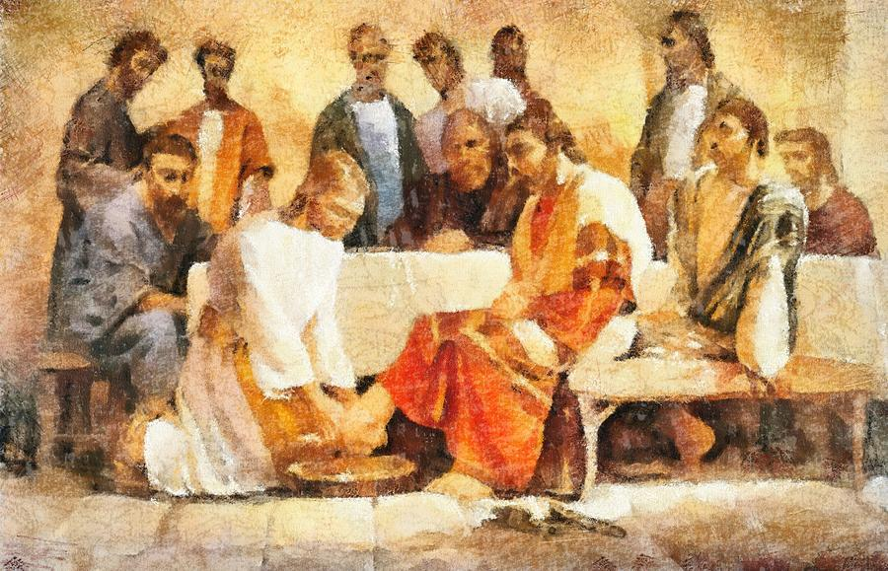
Look at this painting of what happened before the meal.
They are not yet eating together.
Can you explain what Jesus is doing?
Why would this have been important in Jesus’ day?
Painted
by Dan Sproul
Who do you think would normally do this job?

Slide 4
John’s gospel tells us this part of the story.
John - Chapter 13
³ Jesus knew that the Father had given him power over everything. He also knew that he had come from God and was going back to God. ⁴ So during the meal Jesus stood up and took off his outer clothing. Taking a towel, he wrapped it around his waist. ⁵ Then he poured water into a bowl and began to wash the followers’ feet. He dried them with the towel that was wrapped around him.
⁶ Jesus came to Simon Peter. But Peter said to Jesus, “Lord, are you going to wash my feet?”
⁷ Jesus answered, “You don’t understand what I am doing now. But you will understand later.”

Slide 5
The job of washing feet was the job of a slave. People would be wearing sandals and their feet would be very dirty and smelly from walking outside. Not what you would want at the dinner table!
By being the one who chose to do this job, what example do you think Jesus was setting his disciples?
What can you learn from this example?

Slide 6
Jesus knew he was the most important person at the meal, but he was willing to do the job of the least important. Not only did Jesus share a meal, he was also happy to share in this unpleasant job. He showed his disciples, and us, that everyone should serve one another.
Sometimes it is very easy to think that we are too important to do the unpleasant jobs and to want others to serve us. But sharing in getting things done through serving others is a sign of your strength, not a sign of your weakness. It is a demonstration of love and service and is at the heart of a strong family, strong school and strong community.

Slide 7
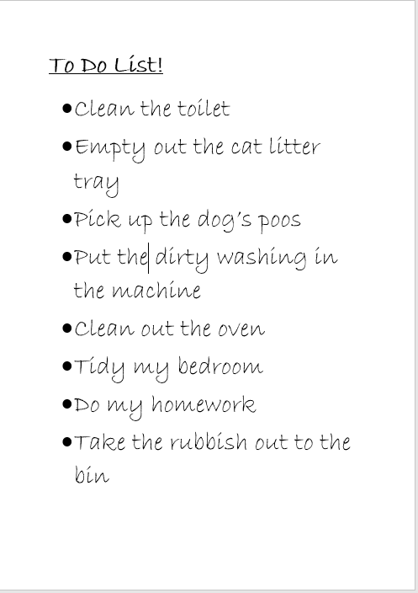
Make a list of all the jobs that are needed at home and who usually does them. Pick one or more that you will do instead.
or
Who do you think you are more important than? How could you show them today that they are just as important as you?

Slide 8
Lord Jesus, Thank you for teaching us that serving others is a sign of strength and love. Show me how to help others by sharing out the jobs that need doing. Amen

Slide 9
This resource was produced by the Diocese of Leeds Education Team. For more information about this or future resources,
please contact your named adviser:
simone.bennett@leeds.anglican.org
simon.sloan@leeds.anglican.org
darren.dudman@leeds.anglican.org
janet.tringham@leeds.anglican.org
lee.talbot@leeds.anglican.org
rupert.madeley@leeds.anglican.org

