Slide 1
Creating

Slide 2
We have learned that after Jesus was baptised by John, he went into the wilderness to pray to God. Today we will begin to find out what happened to him there. Our focus is creating.
Before we start, consider these questions…
What sort of things have you created?
Have they always been the right things at the right time?

Slide 3
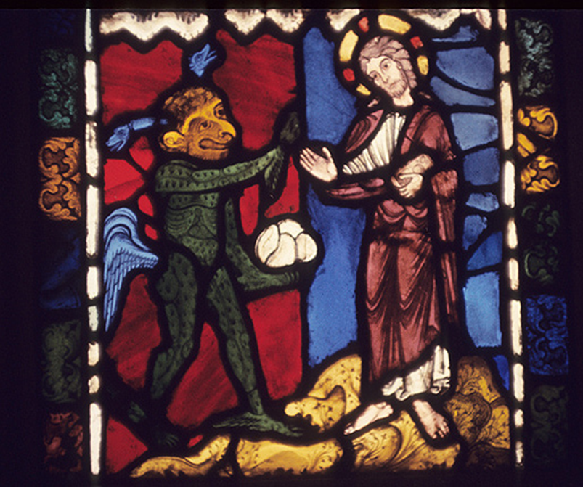
This is a stained glass window, originally from a church. It is now kept at the Victoria and Albert Museum in London.
Who do you think the two figures are?
What is going on?
Look at this picture.

Slide 4
Matthew’s gospel tells us this part of the story.
Matthew - Chapter 4
4 Then the Spirit led Jesus into the desert to be tempted by the devil. ² Jesus ate nothing for 40 days and nights. After this, he was very hungry. ³ The devil came to Jesus to tempt him. The devil said, “If you are the Son of God, tell these rocks to become bread.”
⁴ Jesus answered, “It is written in the Scriptures, ‘A person does not live only by eating bread. But a person lives by everything the Lord says.’”

Slide 5
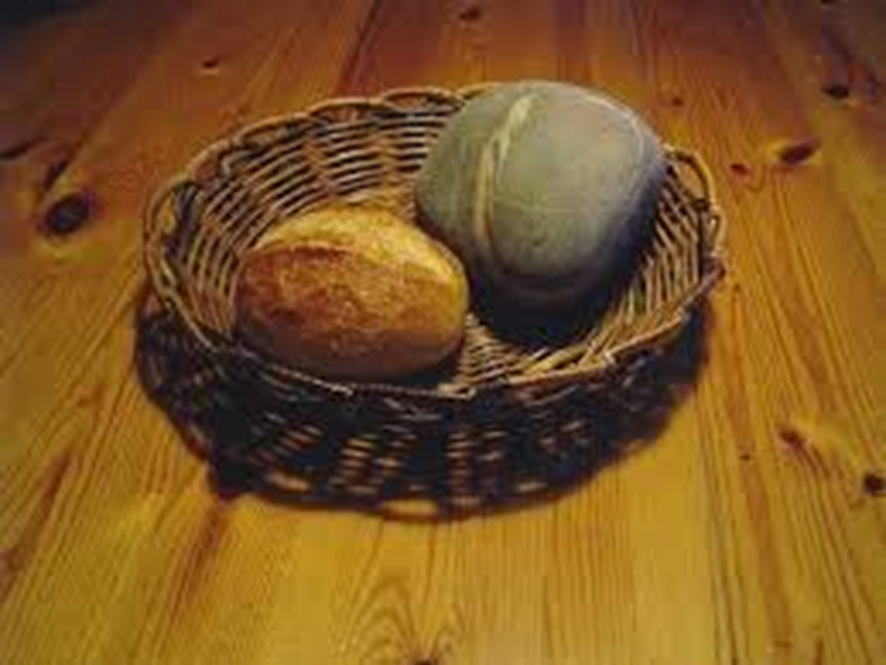
Jesus chose not to create bread out of rocks, even though he had the power to.
Why did he make that choice?
Have you ever found it really hard to resist doing something?
How did that feel?
Have you ever created something that was good for everyone?
Have you ever created something selfishly that had bad consequences?

Slide 6
We have learned about a time when Jesus was really hungry and was tempted to turn rocks into bread. Christians believe that he could easily have done that, because he was filled with the Spirit of God and had immense power at his hands. But even though it meant he stayed hungry, he knew that wouldn’t be the right thing to do, because it would be for selfish reasons. He came to serve others. Remembering what Jesus did can help us to resist temptation and to do the right thing, no matter what, even when it would be easy for us to make the selfish choice.
As humans, we have incredible imagination and creativity. But we have to choose to use this in the right way. Humanity has so often used its creativity to do harm rather than good. In the same way, we can use our creativity and imagination to help or to harm others. Which we do is a daily choice.

Slide 7
Creating some daily goals to help you. For example, next time you have a choice between eating sweets or eating a piece of fruit you may be tempted by the sweets. But if you make the right choice and often eat fruit, you’re going to be much healthier and happier in life.
or
Create a plan with the other people in your house to help to ensure that you always complete your home-learning or chores.

Slide 8
Dear God, thank you for creating everything we see. Thank you for making us creative and full of imagination. Help us all to have the strength to make the right choices and to create wisely for the good of all. Amen.

Slide 9
This resource was produced by the Diocese of Leeds Education Team. For more information about this or future resources,
please contact your named adviser:
simone.bennett@leeds.anglican.org
simon.sloan@leeds.anglican.org
darren.dudman@leeds.anglican.org
janet.tringham@leeds.anglican.org
lee.talbot@leeds.anglican.org
rupert.madeley@leeds.anglican.org

