Slide 1
Story part 4 –
The Garden of Gethsemane and the Cross

Slide 2
As our story continues today, some questions to think about….
When you are struggling with something, what or who helps you?
Are there places you go when you want to be on your own and think?
Who are the people who make you feel better when you feel sad or worried?
Jesus knows that the next few days are going to be very difficult. He leaves the meal with his friends and goes to the Garden of Gethsemane to pray and ask God to help him…

Slide 3
You can read about in Matthew’s gospel. click here to listen
Matthew - Chapter 26
Then Jesus went with his followers to a place called Gethsemane. He said to them, “Sit here while I go over there and pray.” Jesus began to be very sad and troubled. He said to then, “My heart is breaking with sadness. Stay here with me and watch”, but they fell asleep.
Jesus walked a little way away from them. He fell to the ground and prayed, “Father, if it is possible, take this suffering away. But do what you want, not what I want.”
Finding them still asleep, Jesus went away a second time. He prayed, “My Father, if it is not possible for this painful thing to be taken from me, and if I must do it, then I pray that what you want will be done.”
Jesus went away one more time and prayed. Then he went back to the followers and said, “Are you still sleeping and resting? The time has come…Get up. We must go. Here comes the one who has turned against me.”
As he said that, Judas came towards him with the guards.

Slide 4
Spend a couple of minutes to reflect on how Jesus must have felt in the garden.
His friends couldn’t even stay awake with him and he had to find the strength to keep going...
As you listen to this short chant, you might want to think about how you keep going when things are tough. Who helps you? Do you find it easy to ask people to help you?

Slide 5
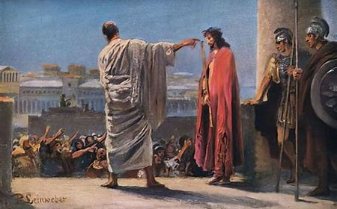
And so, as our story continues, we can walk together through the last events of Good Friday….
Jesus, now under arrest, was taken before Pontius Pilate, the Roman Governor.
The chief priests, who wanted Jesus to die, persuaded the people to set free a murderer called Barabbas. Pilate asked what he should do with Jesus, known as the 'King of the Jews'. 'Crucify him!' shouted the people. Pilate asked 'Why? What has he done?'
The people continued to shout.
Pilate called for a bowl of water and let everyone see him washing his hands of sending an innocent man to death, but he ordered Barabbas to be freed instead.

Slide 6
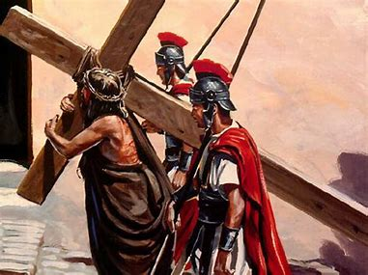
The soldiers took Jesus away, dressed him in a robe and on his head they placed a crown of thorns.
Then they took him away and laid a heavy wooden cross on his back. Jesus was made to carry the cross out of the city gates and up a nearby hill. On the way soldiers mocked him, some of the crowd cheered and others wept.
On top of the hill Jesus was put on the cross and nails were put through his hands and feet. The cross was raised up.
Two robbers were also put on crosses, one on either side of Jesus.

Slide 7
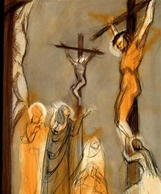
At noon darkness fell on the land. It lasted a few hours. Then Jesus cried out aloud, 'My God, my God, why have you abandoned me?' In the sadness and the dark, Jesus died.
You can click here for music and to listen to the reading
At that moment the earth shook. One of the soldiers who had been keeping guard said, 'This man was the Son of God.‘
Jesus was taken down and placed in a tomb cut into the rock. The tomb was sealed with a large stone.

Slide 8
Putting the story into action…
Christians believe that Jesus, in choosing to die, was making a way for people get to know God better again - a very special gift for them. Think about ways you can give gifts to people through your actions, so that they know how special they are to you. Try one out.
or
Make an Easter action cross. Put something you are going to do in each section – you can have as many or as few as you want to. It might be ‘be kind’, ‘tell the truth’, ‘keep my room tidy’ or ‘tell someone I love them’. See how long it takes you to colour all the sections in.

Slide 9
An invitation to pray…as you reflect and recap the ups and downs of our story today, of Jesus saying ‘your will be done’ even though it was very difficult, you may want to say The Lord’s Prayer…
Our Father in heaven, hallowed be your name, your kingdom come, your will be done, on earth as in heaven. Give us today our daily bread. Forgive us our sins as we forgive those who sin against us. Lead us not into temptation but deliver us from evil. For the kingdom, the power, and the glory are yours now and for ever. Amen.
Or you might want to make up your own prayer today…

Slide 10
This resource was produced by the Diocese of Leeds Education Team. For more information about this or future resources,
please contact your named adviser:
simone.bennett@leeds.anglican.org
simon.sloan@leeds.anglican.org
darren.dudman@leeds.anglican.org
janet.tringham@leeds.anglican.org
lee.talbot@leeds.anglican.org
rupert.madeley@leeds.anglican.org

