Slide 1
Celebrating

Slide 2
Today, our focus is on celebrating. We are continuing to think about when Jesus was baptised.
Before we start, consider these questions…
When someone praises you, how do you feel? What sort of things might we want to praise other people for?
What kind of events do we celebrate? Can you remember any celebrations you have been to?

Slide 3
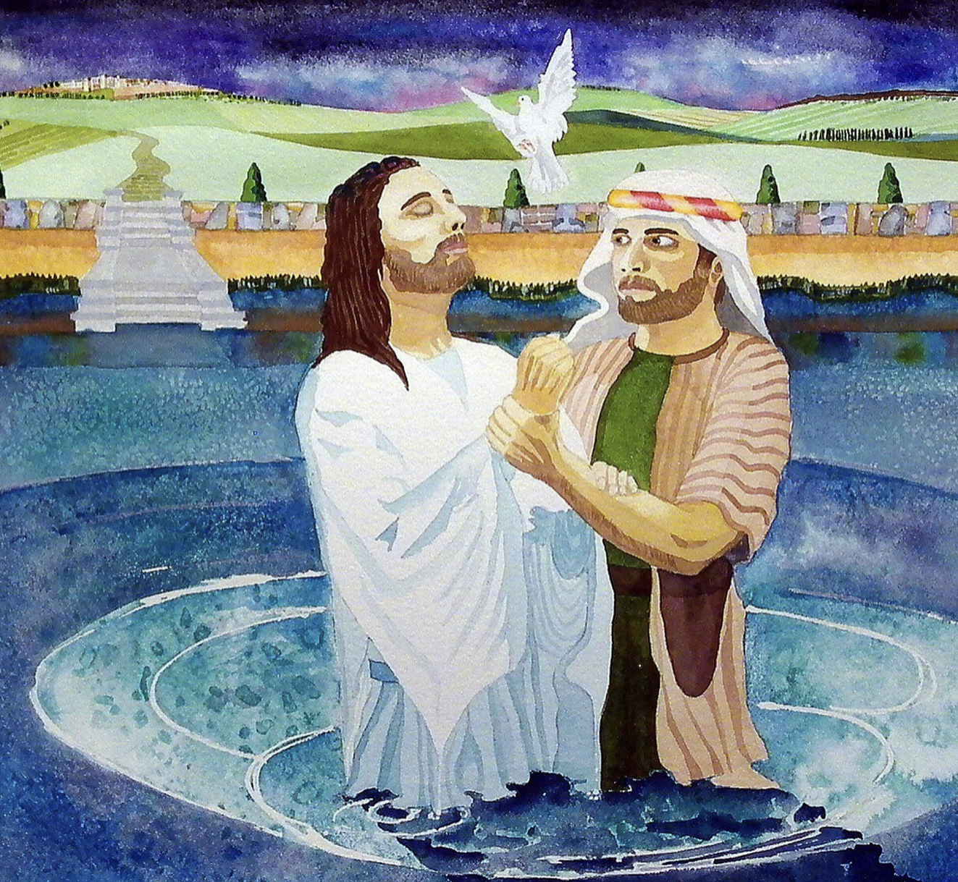
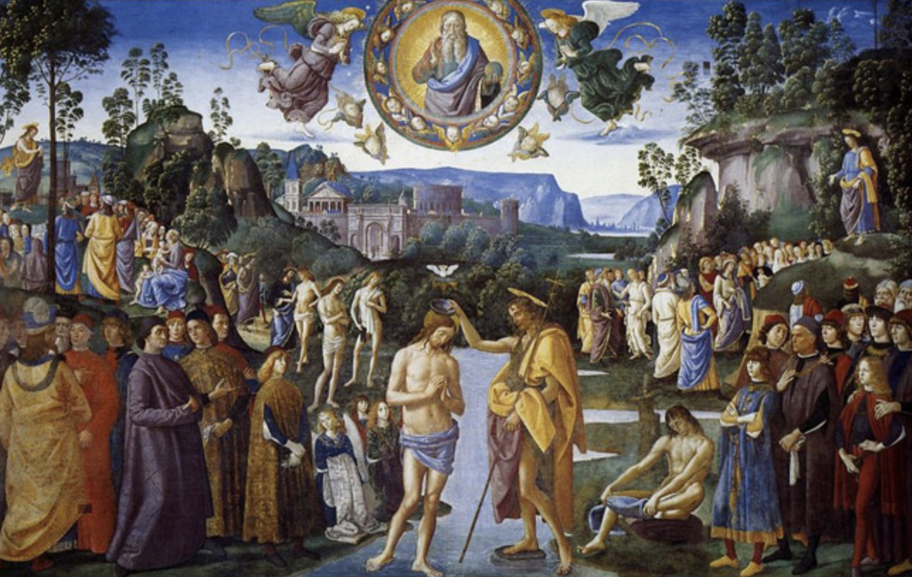
Look at these paintings based on the story.
One is nearly 800 years old. The other is a modern painting.
How are they different?
Which do you like the best and why?

Slide 4
Luke’s gospel tells us this part of the story.
Luke – Chapter 3
²¹ When all the people were being baptized by John, Jesus also was baptized. While Jesus was praying, heaven opened and ²² the Holy Spirit came down on him. The Spirit was in the form of a dove. Then a voice came from heaven and said, “You are my Son and I love you. I am very pleased with you.”

Slide 5
The story tells us that when Jesus was baptised the ‘heavens opened’ and a voice was heard. Whose voice do you think it was?
This happens at the start of Jesus’ ministry, before he has done anything, so why do you think the voice says, “I am very pleased with you”?

Slide 6
In our story today, Jesus was praised just for being himself. God told Jesus that he loved him and that he was pleased with him. Jesus hadn’t done anything special yet, he was just being baptised.
Christians believe that God also loves all of us, just for who we are. We don’t need to do anything special and we sometimes do things wrong, but God celebrates us because he loves us!
Think of how it makes you feel when someone says something good to you. We can make others feel that way by saying positive things about them. We can celebrate them and bring them joy.

Slide 7
Just like in our story, try to praise someone today, just for being who they are!
or
Even when things are hard we can always find something to celebrate and be thankful for. Try to pick at least one thing today to celebrate and say thank you for.

Slide 8
Heavenly Father, thank you that you love me just for being me. I don’t have to do anything special. Help me to celebrate other people and show that I love them, just for being them! Amen

Slide 9
This resource was produced by the Diocese of Leeds Education Team. For more information about this or future resources,
please contact your named adviser:
simone.bennett@leeds.anglican.org
simon.sloan@leeds.anglican.org
darren.dudman@leeds.anglican.org
janet.tringham@leeds.anglican.org
lee.talbot@leeds.anglican.org
rupert.madeley@leeds.anglican.org

