Slide 1
Story part 3 –
Palm Sunday and the Last Supper

Slide 2
In the Christian year, the week before Easter is called Holy Week.
Today our story continues with two key events that happen. The first one is right at the start of the week, as Jesus rode into Jerusalem on Palm Sunday.
What do you already know about that event?
Have a listen to this musical telling of the story to see what else you can find out…

Slide 3
Everyone was so excited and happy on Palm Sunday. It’s hard to believe that just a few days later things would change so much – but Jesus knew.
Later that week, on the day Christians call Maundy Thursday, Jesus celebrated the feast of Passover with his special friends. This meal is known as the Last Supper. You can find out all about what happened below.
The video is 10 minutes long.
If you prefer, you can read about it in Matthew 26:17-30

Slide 4
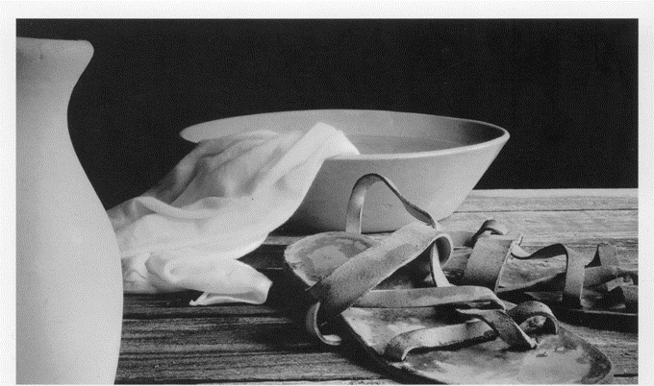
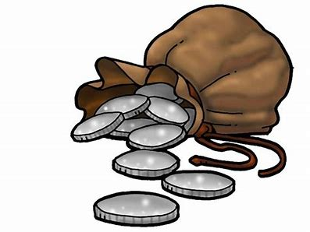
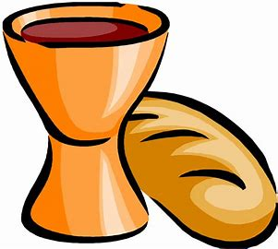
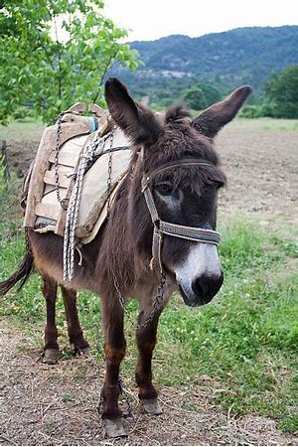
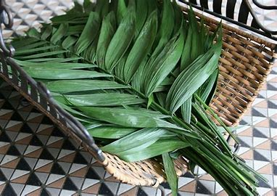
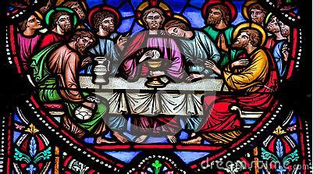
If you had to retell the events of Palm Sunday and Maundy Thursday to someone else, how would these pictures help you?
Can you remember where they fit into the Easter story?

Slide 5
Putting the story into action.
Jesus had to trust God. Are you someone that people can trust? How would you show them they can trust you without saying anything?
or
Imagine you are one of the friends of Jesus. Choose a part of the story today. Write a diary entry or draw a picture to show how you felt or the questions you would want to ask about what was happening.

Slide 6
An invitation to pray…as you reflect and recap the ups and downs of our
story today, you may want to say The Lord’s Prayer…
Our Father in heaven, hallowed be your name, your kingdom come, your will be done, on earth as in heaven. Give us today our daily bread. Forgive us our sins as we forgive those who sin against us. Lead us not into temptation but deliver us from evil. For the kingdom, the power, and the glory are yours now and for ever. Amen.
Pause for thought…
In the different parts of our story today, we see excitement and celebration but also get a glimpse of the challenges still to come.
Through it all, Jesus does what he thinks is right and trusts his father in heaven.
What makes it easy or hard to
trust someone?

Slide 7
This resource was produced by the Diocese of Leeds Education Team. For more information about this or future resources,
please contact your named adviser:
simone.bennett@leeds.anglican.org
simon.sloan@leeds.anglican.org
darren.dudman@leeds.anglican.org
janet.tringham@leeds.anglican.org
lee.talbot@leeds.anglican.org
rupert.madeley@leeds.anglican.org

