Slide 1
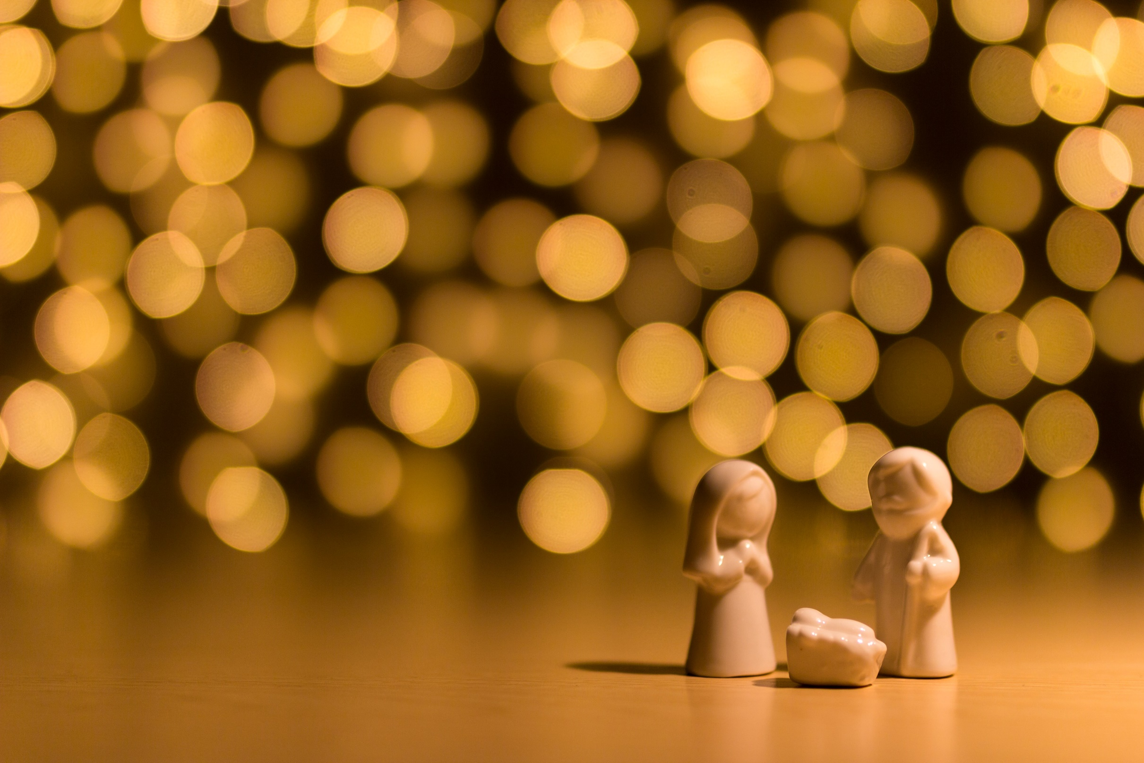
The Rhythm of Life Advent Journey
Creating

Slide 2
Celebration 1
Have a thoughtful look at these images.
Which of these things do you think is the most beautiful?
What about it makes it beautiful?

Slide 3
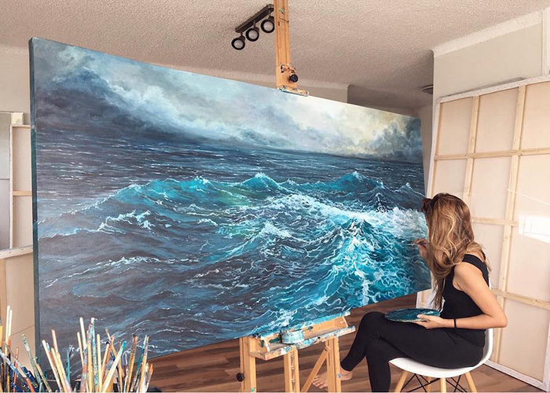
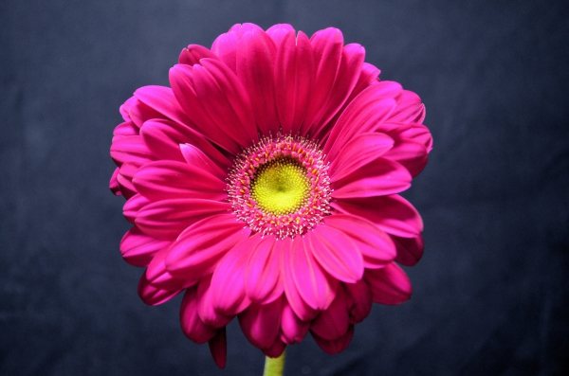
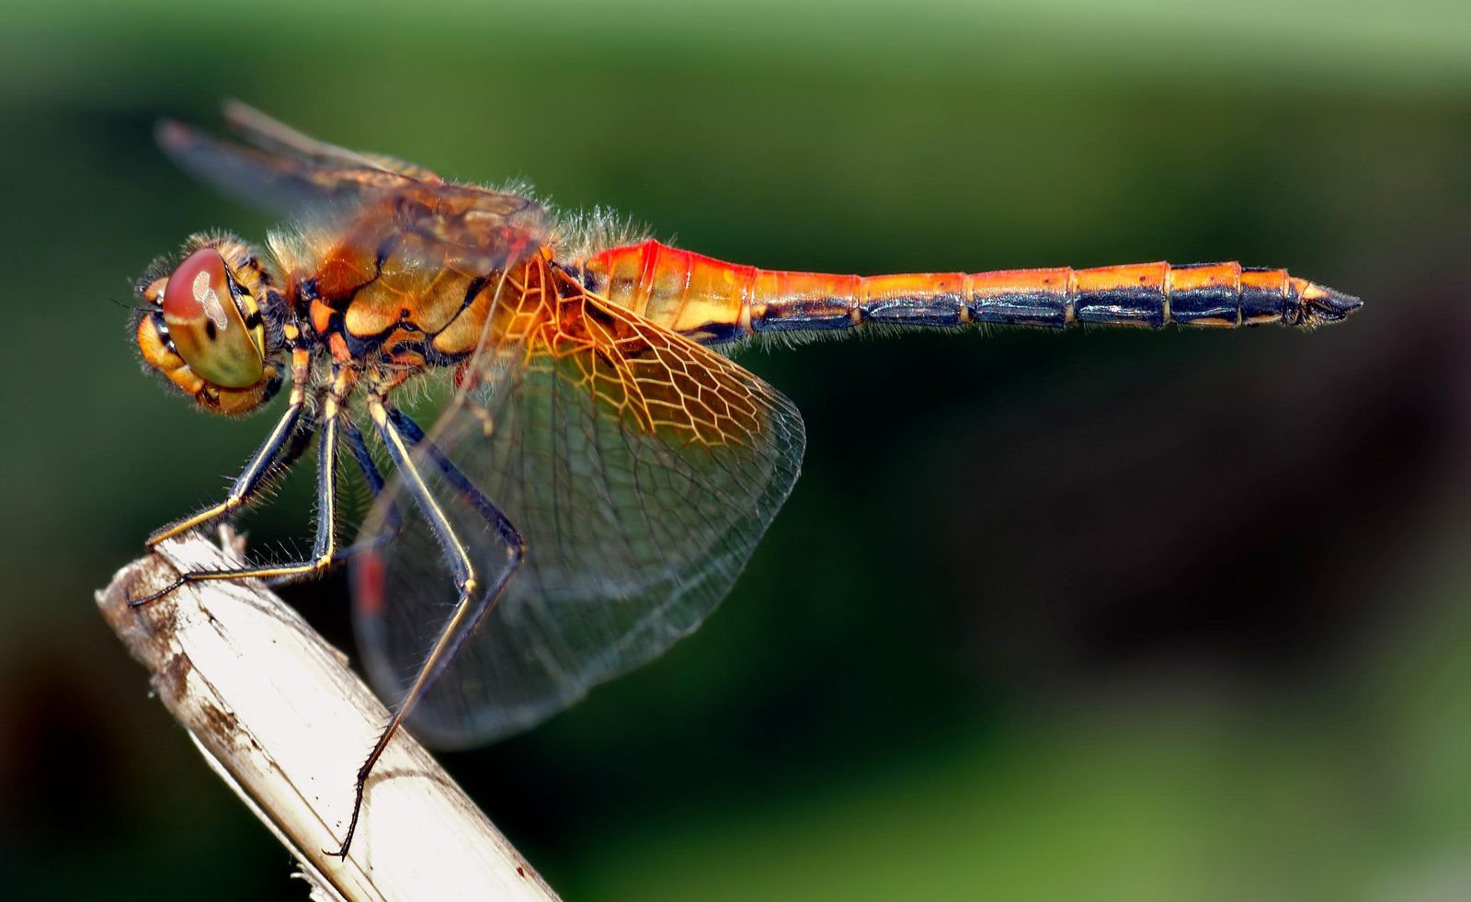
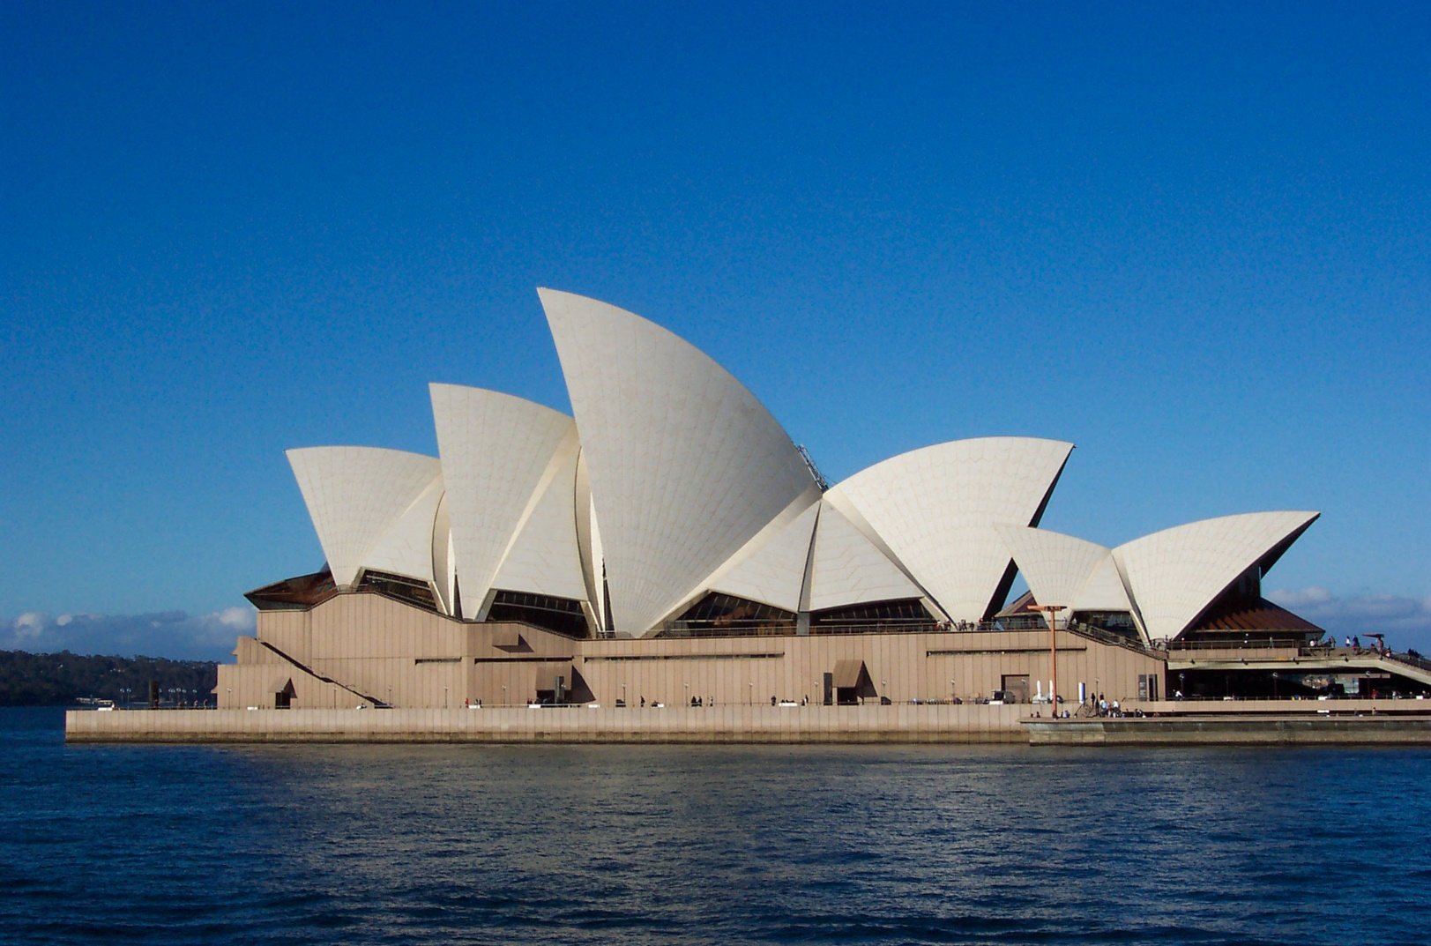
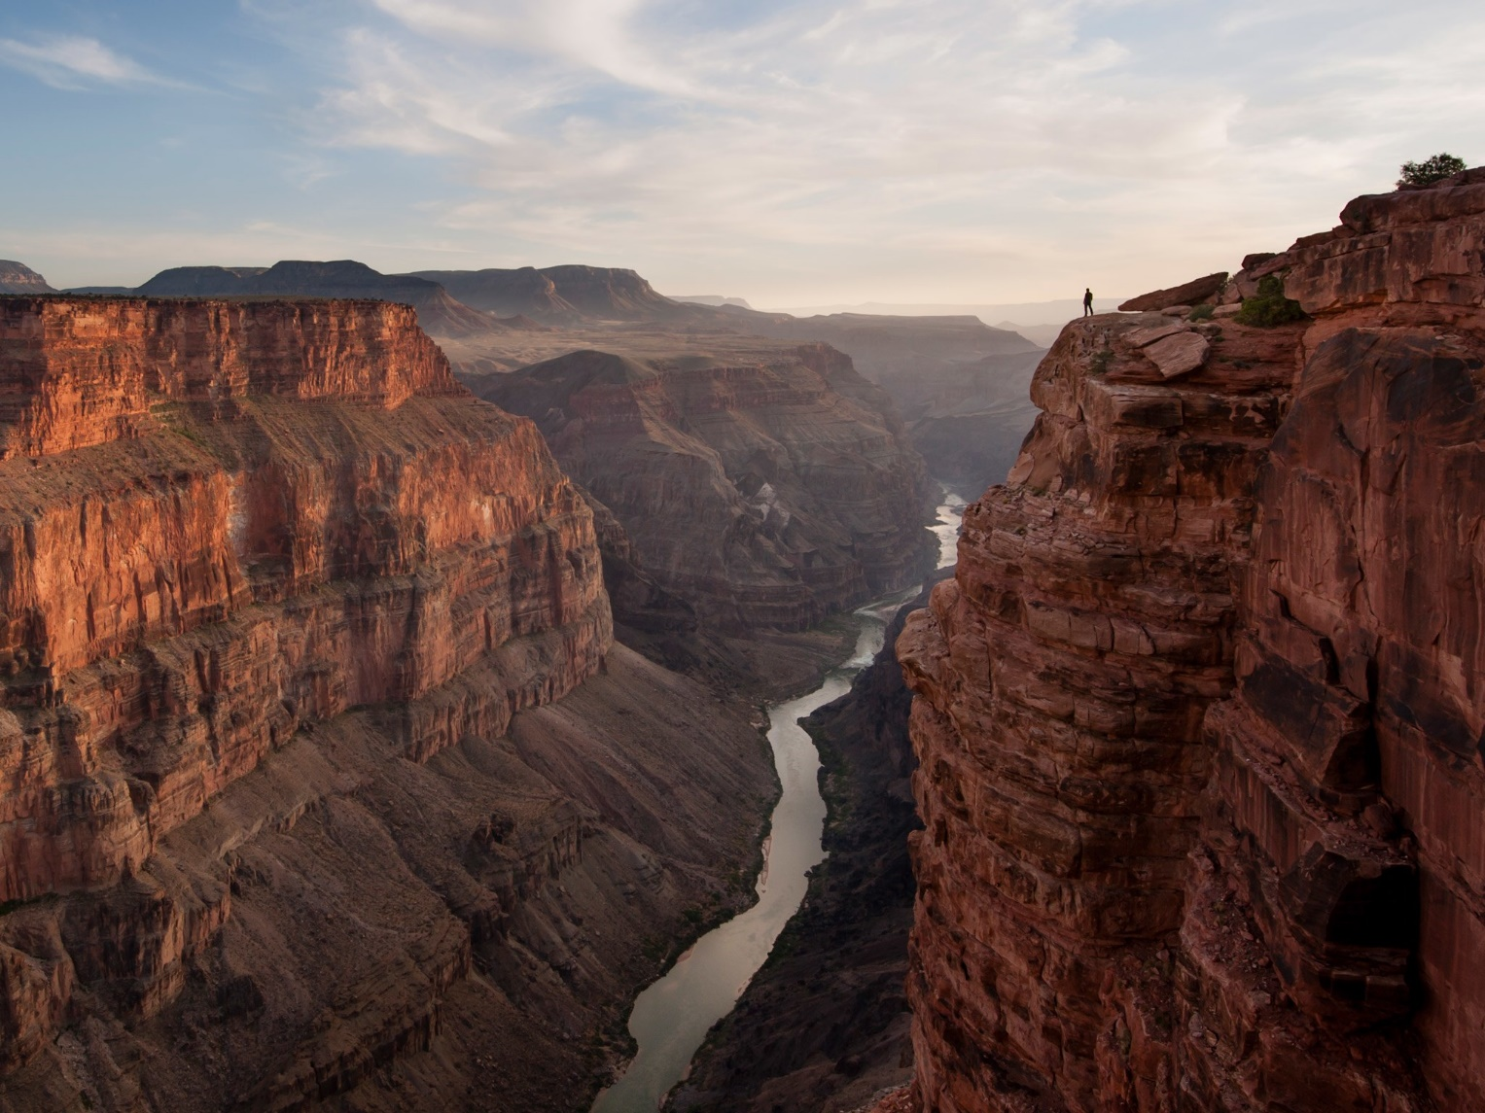
Celebration 1
Which do you think is the most beautiful? What makes it beautiful?

Slide 4
Celebration 1
Which of these do you think is the most beautiful?
What makes it beautiful?
Are the most beautiful things created by humans or by nature?
Does it have to take a long time to produce something beautiful?
Does something have to look beautiful to be beautiful?

Slide 5
Celebration 1
A thought to take away…
Beauty can be found everywhere and absolutely anyone can be creative. We all have special talents – sometimes it takes a while for us to discover what they truly are, but they do reveal themselves eventually. Taking a quiet moment to appreciate the joy of our favourite song or the beauty of a painting is one of the simplest gifts that we are given and one that we could practice every day.

Slide 6
Celebration 1
Today’s Challenge
If you would like to join in with today’s challenge,
why don’t you:
Recreate your favourite poster, piece of art or album cover and put it in a frame for your bedroom wall.
or
Wrap up in your warmest clothes and ask an adult at home to take you somewhere to watch the sun go down or to look at the stars in the night sky.

Slide 7
Celebration 1
If you would like to, you can join in saying these prayers.
A Prayer for the Day
The Rhythm of Life Prayer
Dear Lord,
Help me to live this day with
thanksgiving in my soul,
compassion in my heart and
creativity in my mind.
Help me to see the wonder of your work in all I do.
Amen
Loving God,
Help us to learn from you
the habit of creating
so that the rhythm of our lives can match
the rhythm of your heart of love.
Amen

Slide 8
This resource was produced by the Diocese of Leeds Education Team.
For more information about this or future resources,
please contact your named adviser:
simone.bennett@leeds.anglican.org
simon.sloan@leeds.anglican.org
darren.dudman@leeds.anglican.org
janet.tringham@leeds.anglican.org
lee.talbot@leeds.anglican.org
rupert.madeley@leeds.anglican.org

