Slide 1
Sharing

Slide 2
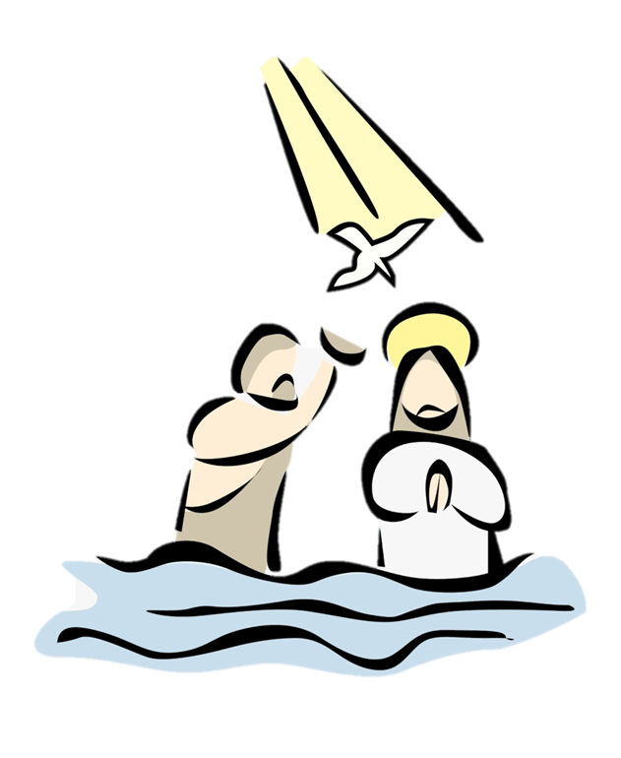
Today our focus is on sharing and we are thinking about when Jesus was baptised.
Before we start, consider these questions…
Have you ever joined a group or organisation?
Did you have to do anything special as you joined or to show you had joined?

Slide 3
Matthew’s gospel tells this part of the story.
Matthew - Chapter 3
¹³ At that time Jesus came from Galilee to the Jordan River. He came to John and wanted John to baptize him. ¹⁴ But John tried to stop him. John said, “Why do you come to me to be baptized? I should be baptized by you!”
¹⁵ Jesus answered, “Let it be this way for now. We should do all things that are right.” So John agreed to baptize Jesus.
¹⁶ Jesus was baptized and came up out of the water. Heaven opened, and he saw God’s Spirit coming down on him like a dove. ¹⁷ And a voice spoke from heaven. The voice said, “This is my Son and I love him. I am very pleased with him.”

Slide 4
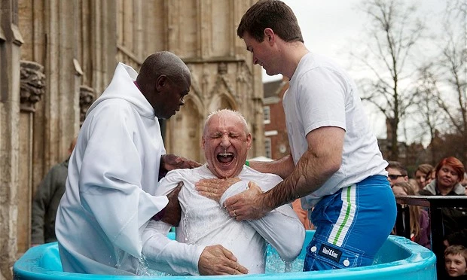
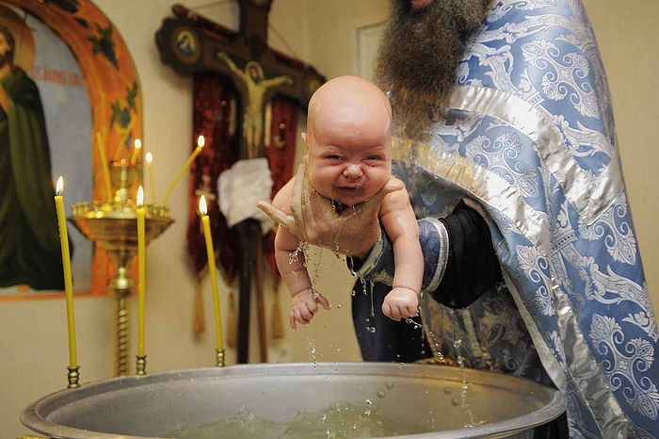
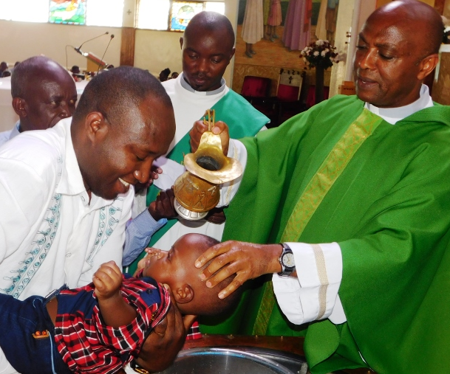
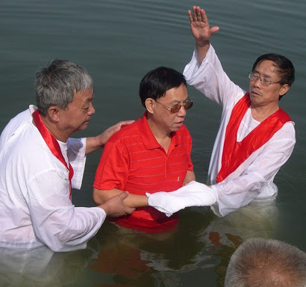
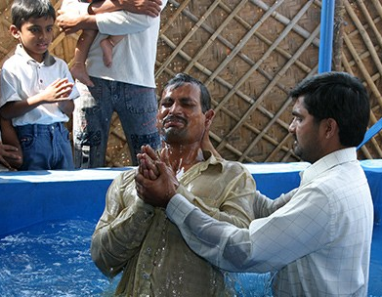
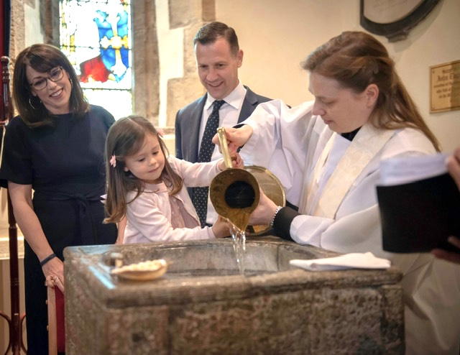
Here are some pictures of Christian baptisms.
What do they have in common?
Christians see baptism as a demonstration that they have joined God’s family.

Slide 5
In the passage, John the Baptist seems unsure about why Jesus wants to be baptised. John thinks he doesn’t need to.
Why do you think that John feels that way?
Can you think of why Jesus might choose to be baptised, even though he doesn’t need to?

Slide 6
By being baptised, Jesus was showing people that he was ‘walking in their shoes’, that he was sharing in their journey of life.
Christians believe this shows that he isn’t a distant god who doesn’t understand us but, instead, he is one who has lived our experiences, both good and bad.
Sharing in someone’s experiences can be a very powerful thing. It shows that you understand what they are going through and are willing to join them in their good times and bad times. This can transform situations and bring people together, even creating bonds that can last a lifetime.

Slide 7
Think of ways you can share your time with somebody today, such as asking somebody you don’t normally play with to join in with you.
or
Check in on a friend to see if they are okay. Listen to them and show them that you are with them in whatever they are facing.

Slide 8
Lord Jesus,​ Thank you that you lived a life like ours, sharing in our human experiences. Help us to find the time to share with others so that we can make their day a better one. Amen​

Slide 9
This resource was produced by the Diocese of Leeds Education Team. For more information about this or future resources,
please contact your named adviser:
simone.bennett@leeds.anglican.org
simon.sloan@leeds.anglican.org
darren.dudman@leeds.anglican.org
janet.tringham@leeds.anglican.org
lee.talbot@leeds.anglican.org
rupert.madeley@leeds.anglican.org

