Slide 1
Learning Objective: To understand how to use pronouns in text
Steps to Success: Pupils can identify and use personal, possessive and relative pronouns in text

Slide 2
Let’s revisit what we should know…
A pronoun takes the place of a noun or noun phrase.
It helps us to avoid repetition in our writing.
he shouted
they thought
it is mine
©Deepening Understanding LTD 2020

Slide 3
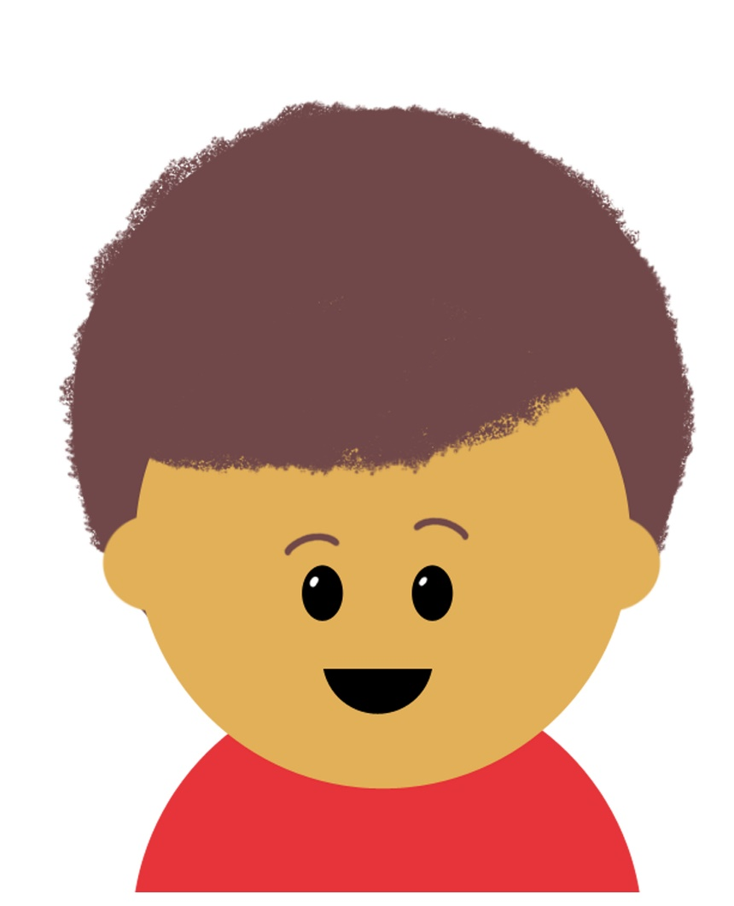
Let’s do this!
Caleb has written the paragraph below…
Discuss with your partner how you could improve his work.
Marlon is my best friend. Marlon and I first met when Marlon and I were in nursery class together. Mine and Marlon’s teacher always says, “Marlon and Caleb are never apart.”
©Deepening Understanding LTD 2020

Slide 4
Let’s revisit what we should know…
There are different types of pronouns.
Some are personal pronouns:
I
me
you
he
she
him
her
us
them
it
we
they
©Deepening Understanding LTD 2020

Slide 5
Let’s revisit what we should know…
There are different types of pronouns.
Some are possessive pronouns:
mine
his
ours
yours
hers
theirs
©Deepening Understanding LTD 2020

Slide 8
Let’s learn
A relative pronoun is a word which refers back to a noun that has already been mentioned in the sentence.
The old, abandoned mansion, which can be found deep inside the forest, has become a tourist attraction.
I’m meeting Caleb at the miniature golf course where Marlon celebrated his tenth birthday.
Last summer, when I travelled to Portugal with my family, I ate seafood for the first time.
©Deepening Understanding LTD 2020

Slide 9
Let’s talk
Complete the sentences using these relative pronouns.
1. Across the road, she noticed the man ________ coat was torn, limping towards the bus stop.
2. It was the ornament ________ his grandmother had passed down to him.
3. Millie lives next door to Mrs Clews ________ is my piano teacher.
that
who
whose
©Deepening Understanding LTD 2020

Slide 10
Let’s talk
How many relative pronouns can you find in the paragraph?
Hawaii, which is an island in the Pacific Ocean, is a very popular tourist destination. It was created from five separate shield volcanos that erupted and overlapped each other. Some people believe Hawaii was named after a legendary navigator called Hawai’iloa who discovered the island. Others think it was named after the legendary realm of Hawaiki where Polynesian people are believed to have originated.
©Deepening Understanding LTD 2020

Slide 12
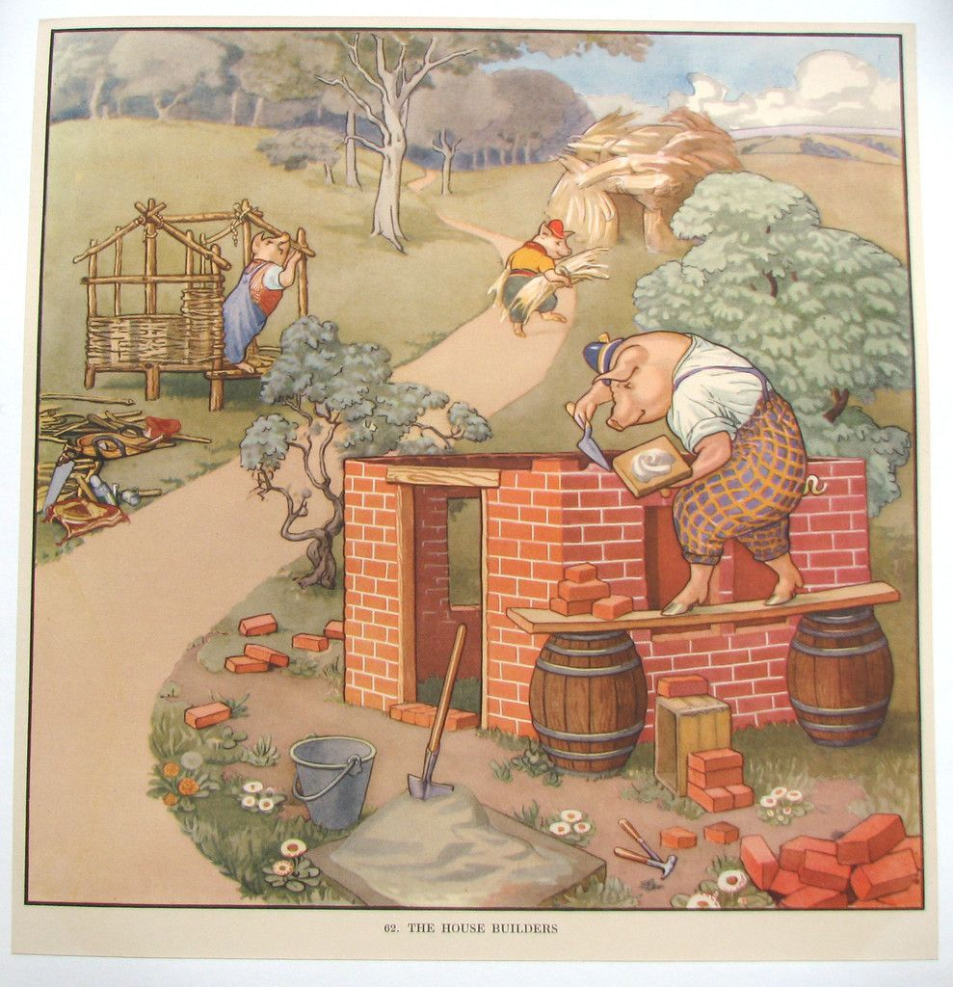
Writing task
Can you create a story based on this picture using pronouns in your sentences?
Challenge: add relative pronouns
Year 6: add relative clauses

