Slide 1
Celebrating

Slide 2
Today, we continue our journey and think carefully about the events which happened following the Resurrection. Our focus is celebrating.
Before we start, consider these questions:
What is the best way of celebrating a special occasion?
Are there any times or occasions when you like to have a quiet moment of celebration?
What would life be like without special celebrations?

Slide 3
Matthew’s gospel tells us this part of the story.
Matthew - Chapter 28
⁸ So the women hurried away from the tomb, afraid yet filled with joy, and ran to tell his disciples. ⁹ Suddenly Jesus met them. “Greetings,” he said. They came to him, clasped his feet and worshipped him.
¹⁰ Then Jesus said to them, “Do not be afraid. Go and tell my brothers to go to Galilee; there they will see me.”
¹¹ While the women were on their way, some of the guards went into the city and reported to the chief priests everything that had happened.

Slide 4
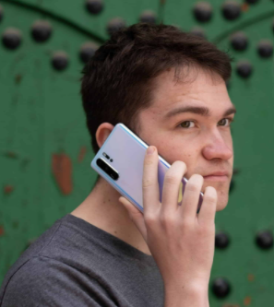
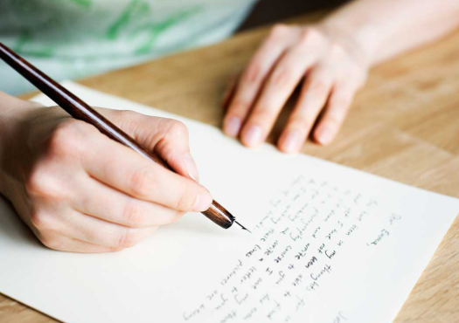
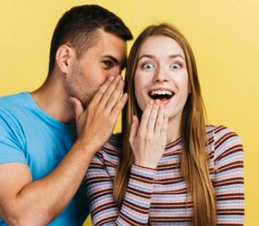
How do you like to receive
special news?
Which of these ways would
mean the most to you?
How do you think the women would have spread the news if this event happened in 2021?

Slide 5
A thought for today…
Imagine the scene, with the women rushing to the disciples – knowing that all is not lost, that something wonderful has happened. The women were sharing the celebration; sharing hope.
The women were no doubt scared and confused but also joyful at what they had seen; even more so when they met the risen Jesus himself. They wanted to share that wonderful news, to tell the rest of Jesus’ friends what they had seen. Their hope had been restored and they could now restore the hope of others.
Celebration likes company. When we have great news, we want to share it with others. Celebrating together can lift up everyone and can give us hope for the future.

Slide 6
Putting celebrating into action!
You might want to try:
Paint or draw an abstract picture of your favourite ever celebration. Try to use as many vibrant colours as you can in the image.
or
Write a list of five inspirational people, whose achievements you would like to celebrate. Next to their name, write what they achieved and why you chose them.

Slide 7
Heavenly Father, Help us to celebrate the wonders we see in your world, as those who saw the risen Jesus did. Help us see the wonder in his resurrection and the good news that it brings. Amen

Slide 8
This resource was produced by the Diocese of Leeds Education Team. For more information about this or future resources,
please contact your named adviser:
simone.bennett@leeds.anglican.org
simon.sloan@leeds.anglican.org
darren.dudman@leeds.anglican.org
janet.tringham@leeds.anglican.org
lee.talbot@leeds.anglican.org
rupert.madeley@leeds.anglican.org

