Slide 1
Creating

Slide 2
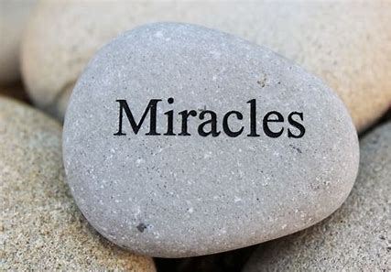
Have you ever been so totally amazed by something, that you wonder if it could be true at all?
There are some things that can’t be explained – some people might call them miracles. Can you think of any ‘everyday miracles’? Miracle stories in the Bible or other holy books?
As we move towards the end of the Easter story, on the third day after his death on the cross, Jesus certainly had a surprise for his followers…do you know what it was?

Slide 3
Jesus comes back to life! This is called The Resurrection.
We can read about it in Matthew’s gospel
Matthew - Chapter 28
Click this symbol if you’d like to listen too.
At dawn on the first day of the week, Mary Magdalene and another woman named Mary went to look at the tomb.
At that time there was a strong earthquake. An angel of the Lord rolled the stone away from the entrance. He was shining as bright as lightning. His clothes were white as snow. The soldiers guarding the tomb were very frightened of the angel.
The angel said to the women, “Don’t be afraid. I know that you are looking for Jesus, the one who was killed on the cross. But he is not here. He has risen from death as he said he would. Come and see the place where his body was. And go quickly and tell his followers. Say to them: ‘Jesus has risen from death. He is going into Galilee. He will be there before you. You will see him there”

Slide 4
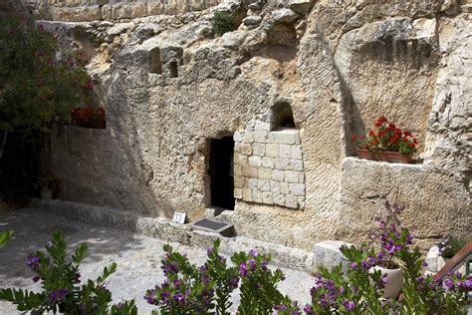
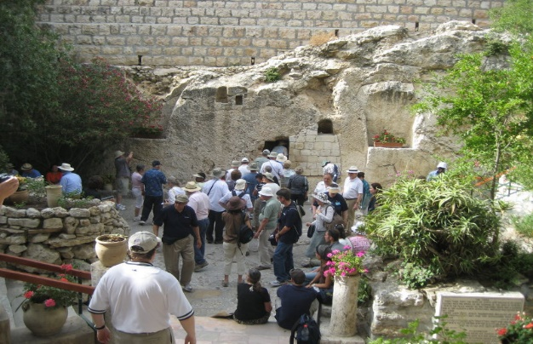
These pictures are of the Garden Tomb in Jerusalem. Many Christians believe that this is the place we heard about in the reading today…
Every year thousands of Christians visit. Why do you think they want to do that?
Lots of people who visit are not Christians. Why do you think they might want to go? How might their experience be different?
There are other places that some people believe could be the location of the tomb of Jesus. Do you think it matters who is right?
Are there places that are important to you or that help you to remember special times or events?
You can find out more about the Garden tomb at www.gardentomb.com

Slide 5
A thought for today… Click this symbol if you’d like to listen too.
It can be difficult to accept events that we don’t understand. Jesus’ resurrection was something completely new and those closest to him didn’t know what to think!
Christians believe you don’t have to understand everything. On Easter Sunday God was showing his amazing power, even over death. By dying and rising again Jesus was creating a chance for God and his people to begin all over again, with all the bad things put right.
There are times when we find it hard to get things wrong or we don’t know how to make something right. We can forget that every day is a new start, maybe even several times a day!
Yet, when we keep going, sometimes unexpected things can happen and just like God’s new start with his people, we might create new ways to do things – some that are even better than the ones we had before.
Every day can be a miracle.

Slide 6
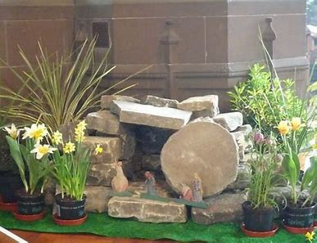
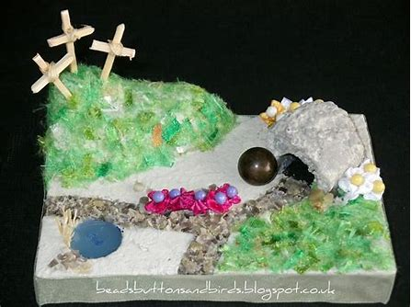
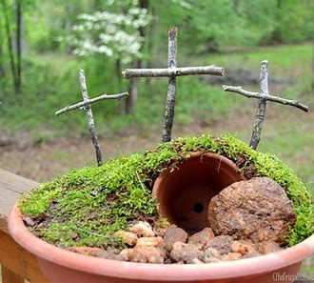
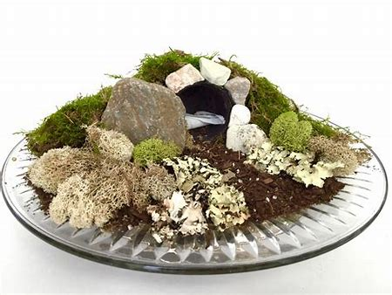
Putting creating into action!
Find something that you can mend or recycle to use in a new way today – it might be a friendship, clothes or something you can make to use at home.
or
Create an Easter Garden to remember the story we have heard. There are lots of ways you can do it!

Slide 7
Heavenly Father, as we remember the resurrection, we give thanks for the gift of unexpected things, for special times and special places. Help us to live each day being open to the possibility of a miracle. Amen

Slide 8
This resource was produced by the Diocese of Leeds Education Team. For more information about this or future resources,
please contact your named adviser:
simone.bennett@leeds.anglican.org
simon.sloan@leeds.anglican.org
darren.dudman@leeds.anglican.org
janet.tringham@leeds.anglican.org
lee.talbot@leeds.anglican.org
rupert.madeley@leeds.anglican.org

