Slide 1
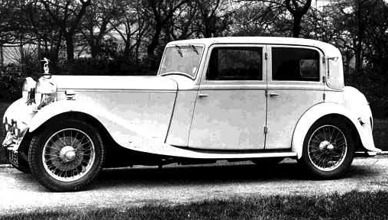
Transport within Living Memory Cars
KS1 Topic: Changes within Living Memory Block C: Transport Session 1
A car from 1930s – when great-granny might have been young.
© Original resource copyright Hamilton Trust, who give permission for it to be adapted as wished by individual users.
We refer you to our warning, at the foot of the block overview, about links to other websites.

Slide 2
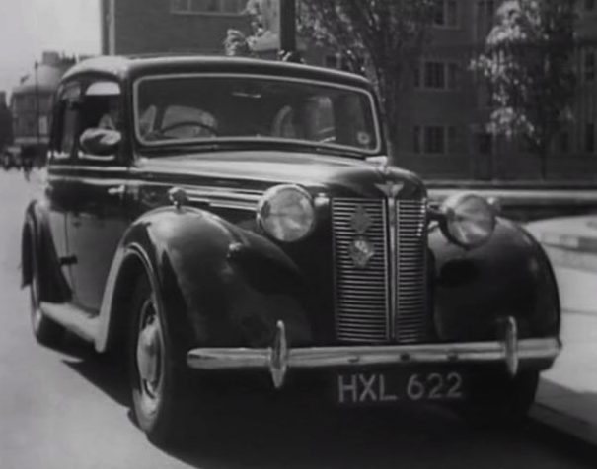
Transport within Living Memory Cars
A car from 1940s – when great-granny might have been young.

Slide 3
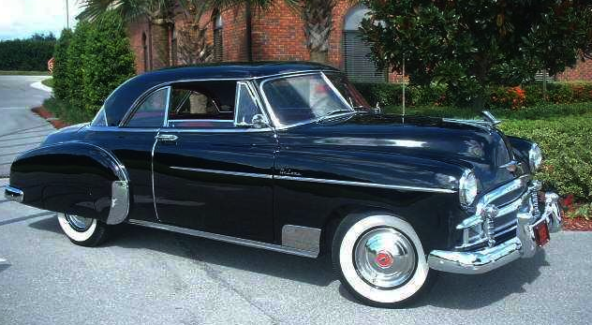
Transport within Living Memory Cars
A car from 1950s – probably just before grandparents were born.

Slide 4
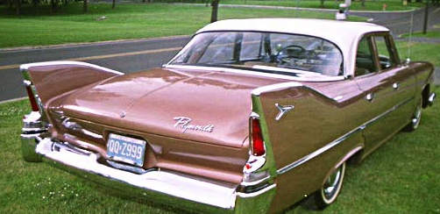
Transport within Living Memory Cars
A car from 1960s – when grandparents might have been young.

Slide 5
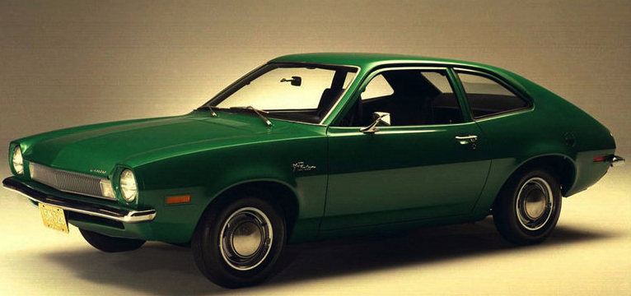
Transport within Living Memory Cars
A car from 1970s – when grandparents were young adults.

Slide 6
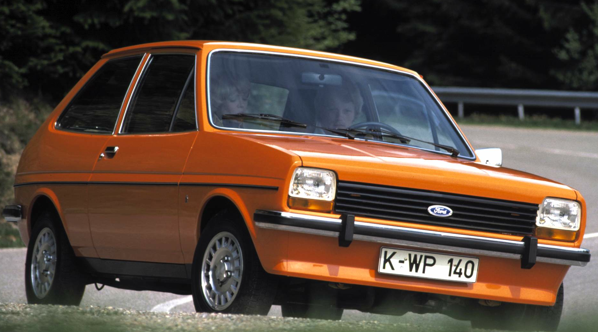
Transport within Living Memory Cars
A car from 1980s – when parents might have been young.

Slide 7
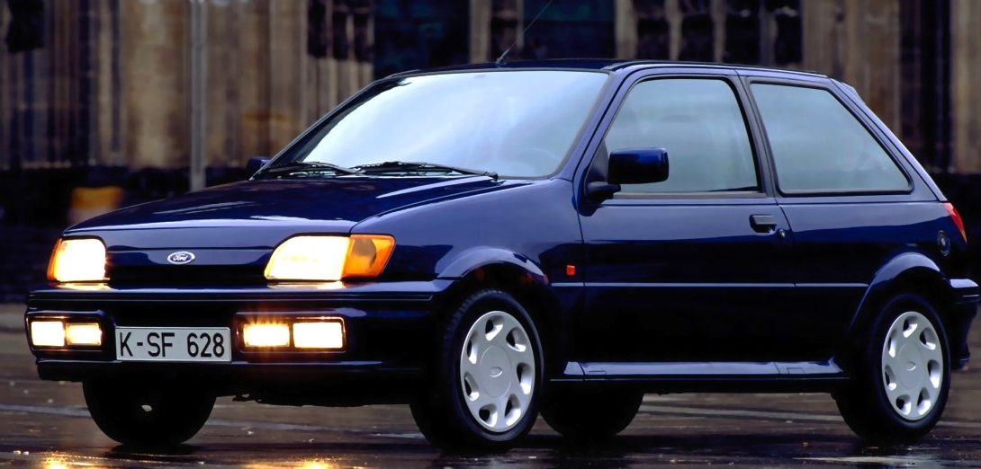
Transport within Living Memory Cars
A car from 1990s – when parents were young.

Slide 8
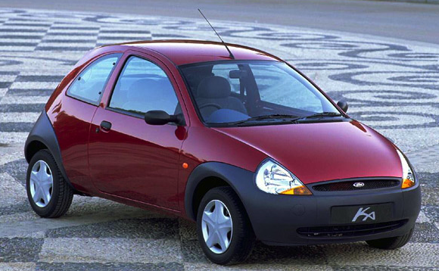
Transport within Living Memory Cars
A car from 2000s – when parents were younger.

Slide 9
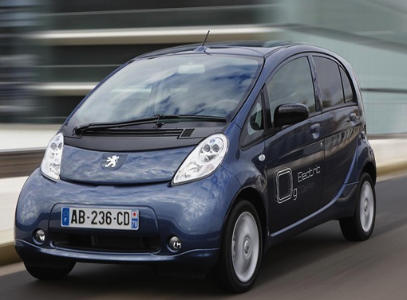
Transport within Living Memory Cars
An electric car from 2010 – no petrol or diesel!

Slide 10
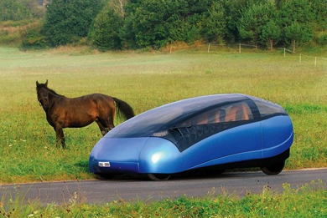
Transport within Living Memory Cars
A green car from 2010 – no petrol or diesel!

Slide 11
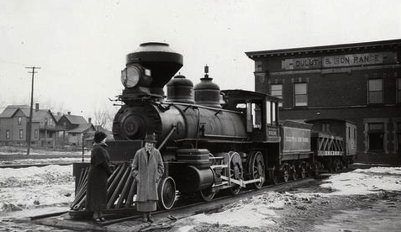
Transport within Living Memory Trains
A train from 1930s – when great-granny might have been young.

Slide 12
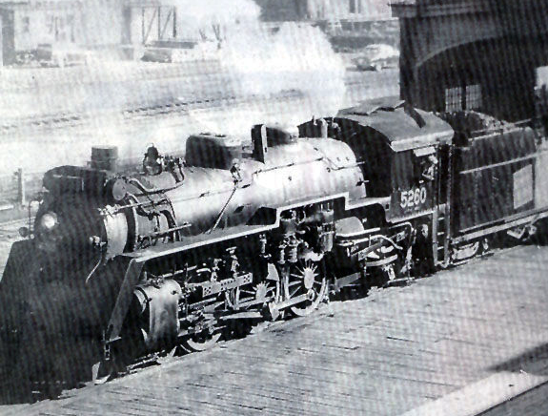
Transport within Living Memory Trains
A train from 1950s – probably just before grandparents were born.

Slide 13
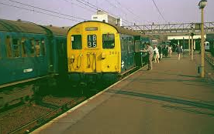
Transport within Living Memory Trains
A train from 1970s – when grandparents were young adults.

Slide 14
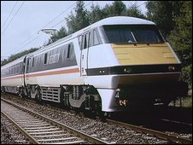
Transport within Living Memory Trains
A train from 1990s – when parents were young.

Slide 15
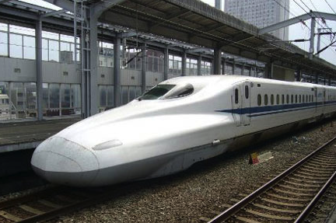
Transport within Living Memory Trains
A bullet train in Japan 2014

Slide 16
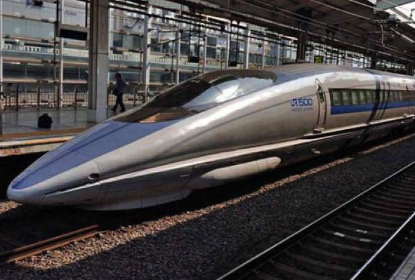
Transport within Living Memory Trains
A bullet train in Japan 2014

