Slide 1
Praying

Slide 2
Today our focus is on praying and we are thinking about the story of Jesus going to the Garden of Gethsemane.
Before we start, consider these questions…
Have you ever felt worried or sad?
What do you do when you feel that way?

Slide 3
Mark’s gospel tells us this part of the story.
³² Jesus and his followers went to a place called Gethsemane. He said to his followers, “Sit here while I pray.” ³³ Jesus told Peter, James, and John to come with him.
Then Jesus began to be very sad and troubled. ³⁴ He said to them, “I am full of sorrow. My heart is breaking with sadness. Stay here and watch.”
³⁵ Jesus walked a little farther away from them. Then he fell on the ground and prayed.
Mark - Chapter 24

Slide 4
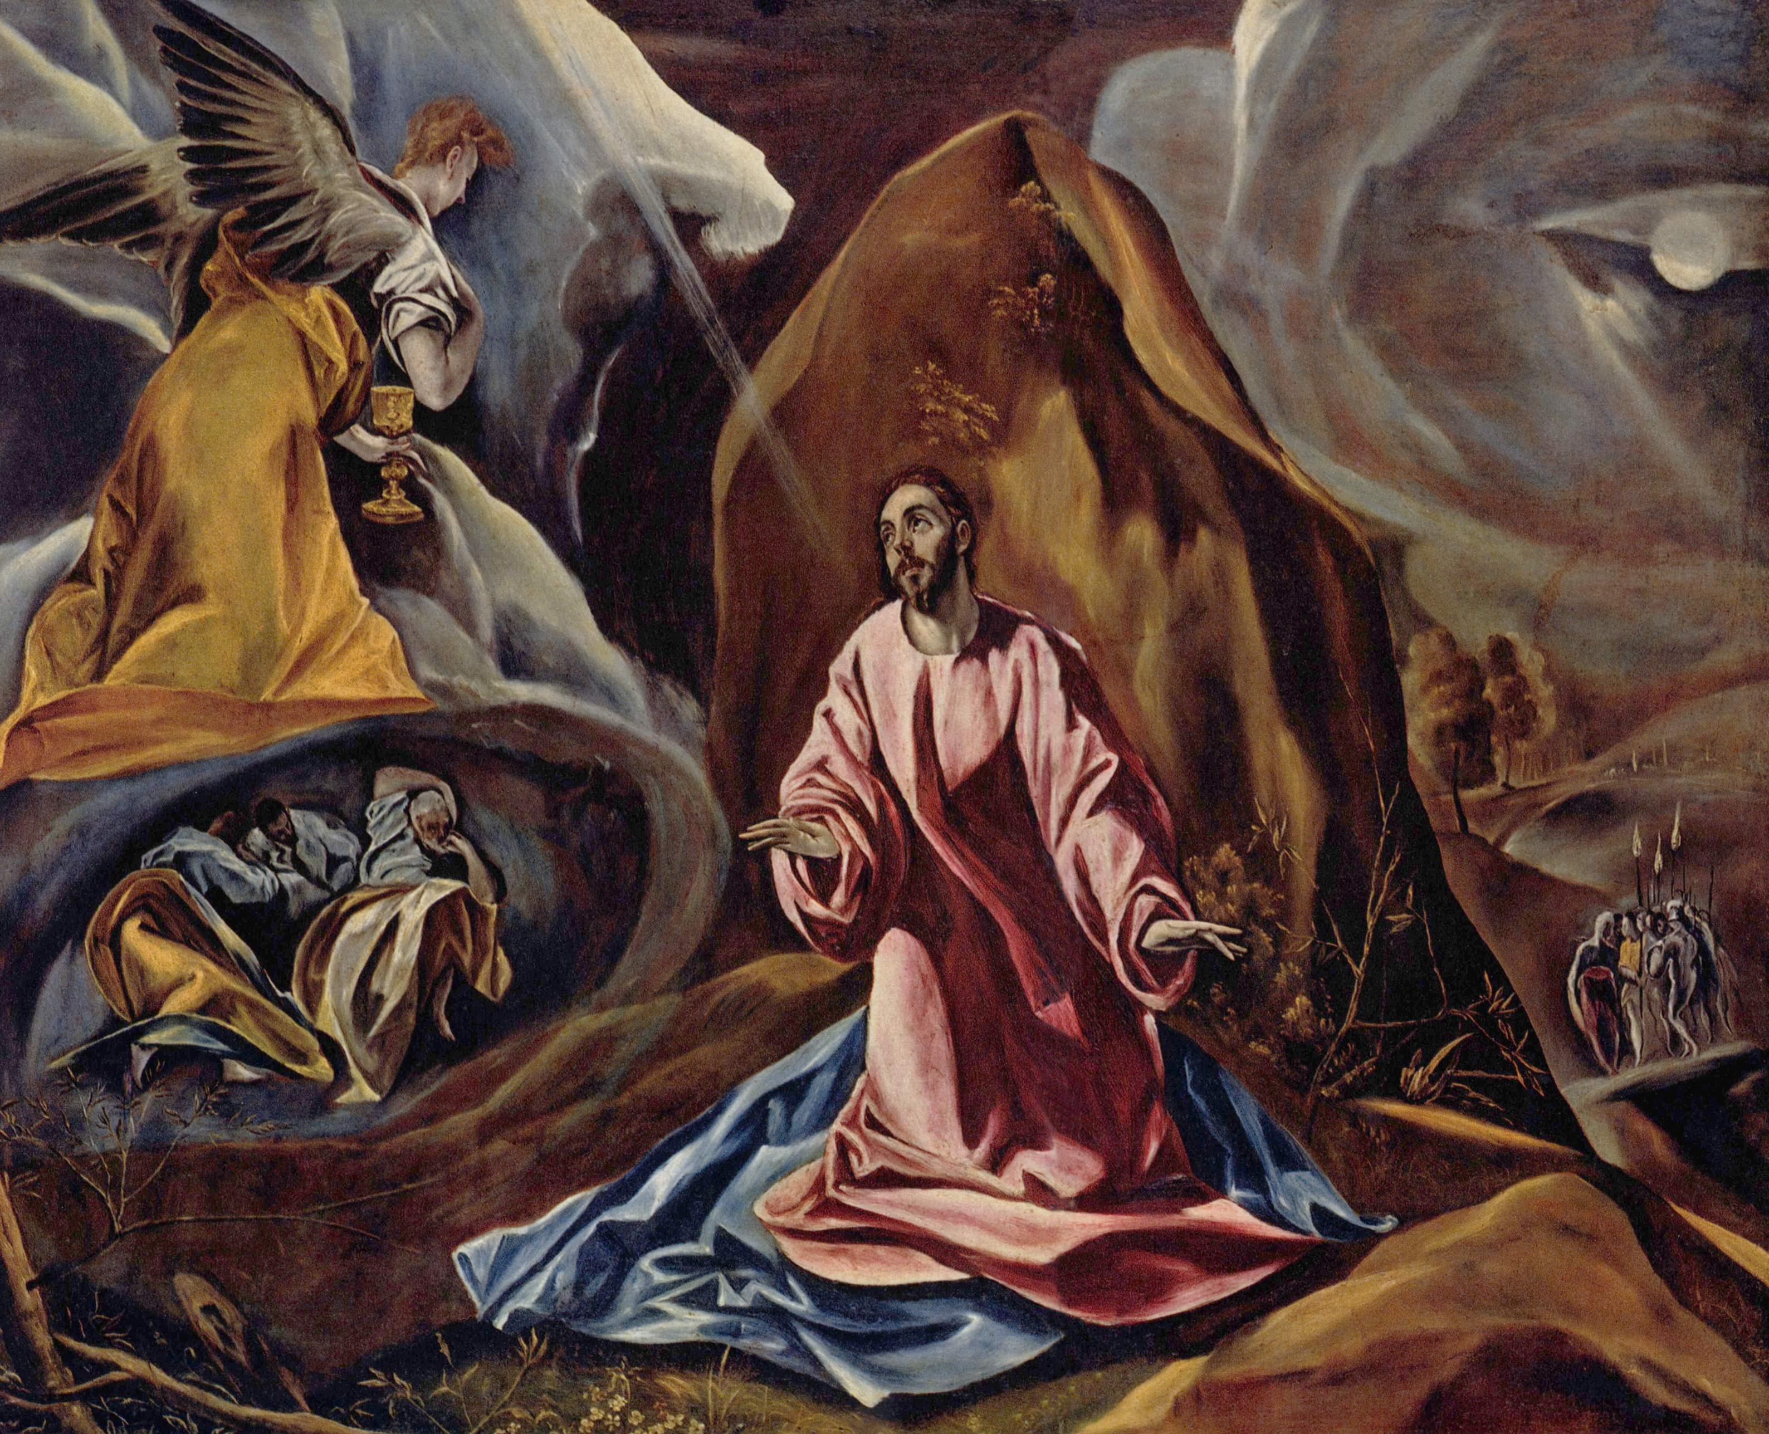
Can you see Jesus praying?
Can you find Peter, James and John?
What are they doing?
Who is in the background of this picture (bottom right) and what do you think they are saying?
Why do you think this painting is called
The Agony in the Garden of Gethsemane.
‘The Agony in the Garden of Gethsemane’ by the famous artist El Greco

Slide 5
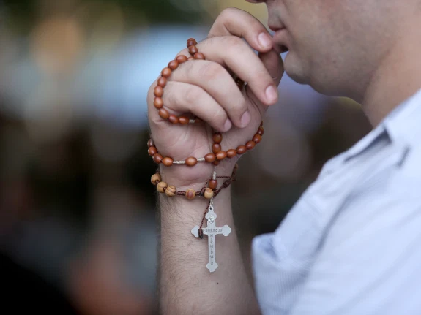
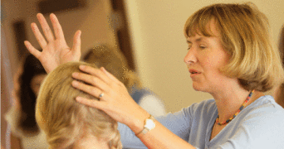
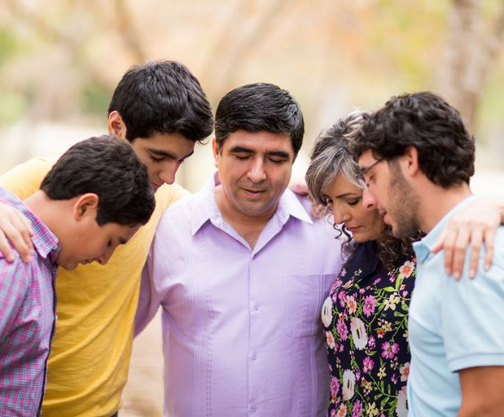
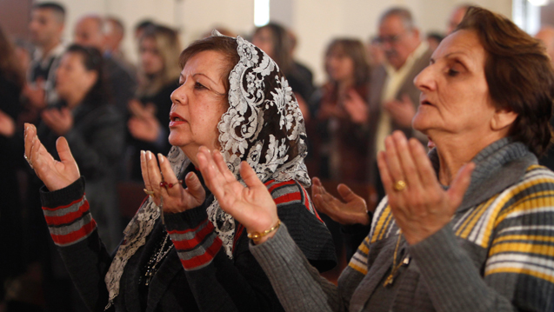
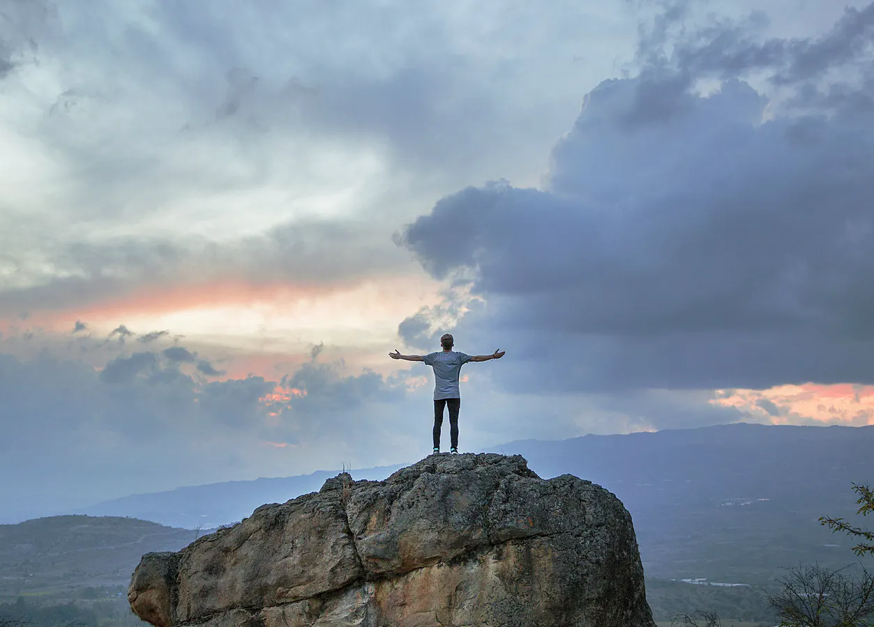
Jesus chose to be alone with God when He was praying.
As you can see, Christians today choose to pray in many ways. They are comfortable sharing their thoughts and feelings because they believe that God knows them, inside and out.
What are the differences you see in the way that these people are praying?
Does it matter that there are differences? What is the same for all of them?

Slide 6
People of faith often turn to prayer during times of worry or upset.
It gives them strength and encouragement. At this time, when Jesus was most worried and distressed, he prayed, just like he prayed in the wilderness at the start of his ministry and on many other occasions too.
It is important that when you are anxious or sad that you share it with someone close. That can be by praying to God, but it can also be by talking to someone. It is an important part of staying healthy. There is a saying, a problem shared is a problem halved, which means it can help if you don’t keep your worries to yourself.

Slide 7
Putting praying into action:
You might like to try…
If you know somebody who has worries or is upset you could write or say a prayer today.
or
You could create a ‘God knows me’ box. Write your name on the box and fill it with items which represent you. Say a prayer of thanks to God because he knows you so well and keep it as a reminder.

Slide 8
Father God, thank you for knowing me so well that I can talk to you in good times and bad. There are many people who are sad, upset or who feel alone in the world. Please comfort, support and guide them today. Amen

Slide 9
This resource was produced by the Diocese of Leeds Education Team. For more information about this or future resources,
please contact your named adviser:
simone.bennett@leeds.anglican.org
simon.sloan@leeds.anglican.org
darren.dudman@leeds.anglican.org
janet.tringham@leeds.anglican.org
lee.talbot@leeds.anglican.org
rupert.madeley@leeds.anglican.org

