Slide 1
Reflecting

Slide 2
Today, we are looking at reflecting. We continue our journey by thinking carefully about the events of Palm Sunday.
Before we start, consider these questions:
What do you do when you’re confused or you really don’t understand something?
Do you have any strategies to help work things out yourself?
If you turn to someone else, who is the first person you ask?
Why them?

Slide 3
Matthew’s gospel tells us this part of the story.
Matthew - Chapter 21
⁷ ...They laid their coats on the donkeys, and Jesus sat on them. ⁸ Many people spread their coats on the road before Jesus. Others cut branches from the trees and spread them on the road. ⁹ Some of the people were walking ahead of Jesus. Others were walking behind him. All the people were shouting, “Praise to the Son of David! God bless the One who comes in the name of the Lord! Praise to God in heaven!”
¹⁰ Then Jesus went into Jerusalem. The city was filled with excitement. The people asked, “Who is this man?”
¹¹ The crowd answered, “This man is Jesus. He is the prophet from
the town of Nazareth in Galilee.”

Slide 4
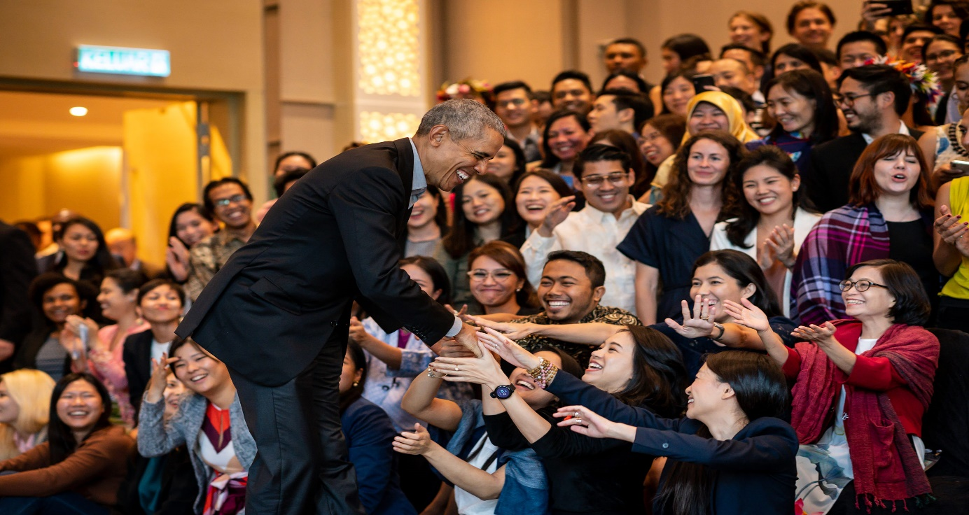
Thinking about the excitement of the crowd:
Why are the people in the photographs excited? How do you know?
What would the noise be like in each of these places?
If you could choose ONE person to be in the
pictures, who would it be and why?

Slide 5
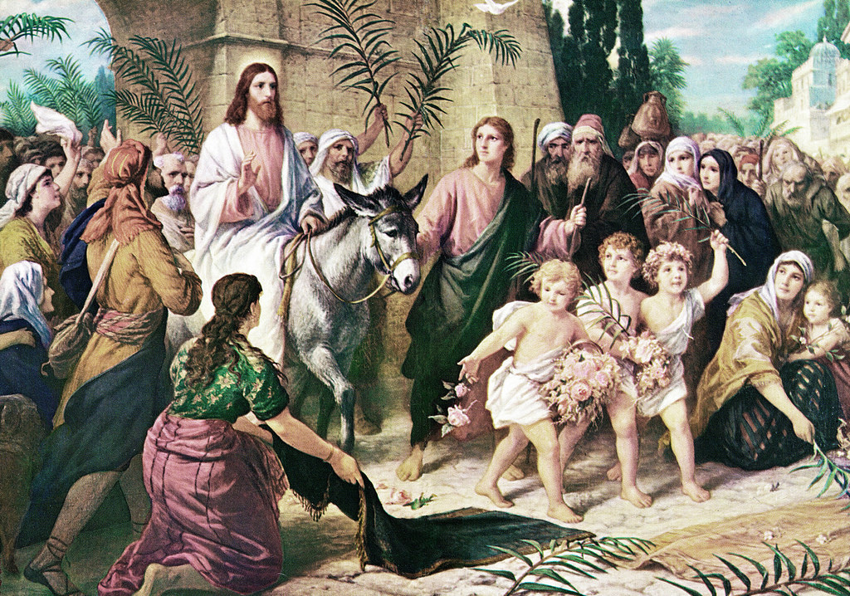
Do you think Jesus’ arrival would have really looked like this?
What do you think the painting has got right and what has it got wrong?

Slide 6
A thought for today…
On Palm Sunday, the crowds were celebrating. But really, they didn’t understand what was unfolding before them. They were swept along in the excitement. They were shouting and praising, although they didn’t really know what Jesus had come to do. It would only be a week later that the same crowd would be calling for him to be killed.
But Jesus didn’t get carried away. He knew what he had come to do and stayed focused on completing that work.
Being reflective can help us to understand the real picture and not simply be swept along by the flow. If we are not reflective, we can so easily get carried away with our own ideas or with the feelings of the crowd. By reflecting on things, we can put them in perspective, keep them balanced and keep our eyes on those things that are truly important.

Slide 7
Putting reflecting into action!
You might want to try:
Start a journal and each day list the things you have found hard to do and also the way that you have overcome these things. Can you write a list of the people who helped you?
or
Each day for at least a week, write down THREE good things that happened to you!

Slide 8
Dear Lord, help us never just to follow the crowd, but to welcome you into our lives as you were welcomed into Jerusalem. Amen

Slide 9
This resource was produced by the Diocese of Leeds Education Team. For more information about this or future resources,
please contact your named adviser:
simone.bennett@leeds.anglican.org
simon.sloan@leeds.anglican.org
darren.dudman@leeds.anglican.org
janet.tringham@leeds.anglican.org
lee.talbot@leeds.anglican.org
rupert.madeley@leeds.anglican.org

