Slide 1
Creation and science: conflicting or complementary?
Creation/Fall – RE Lesson 4
Notes:
Flip chart and postit notes – pre topic assessment – thoughts
Take picture of answers to stick in books

Slide 2
Learning intention To understand why many Christians find science and faith go together.

Slide 3
Steps to Success
Pupils are able to comfortably discuss information on individuals who find science and Christianity complementary.
Blooms
Understand

Slide 4
Recap of lesson three
Can you compose a question to ask a scientist who may also be a Christian?
Notes:
Answers and discussion from class answers from last lesson

Slide 6
Scientists who believe Creation and science can be complementary

Slide 7
Lets hear from them… After each video discuss and write one summary statement with your partner

Slide 8
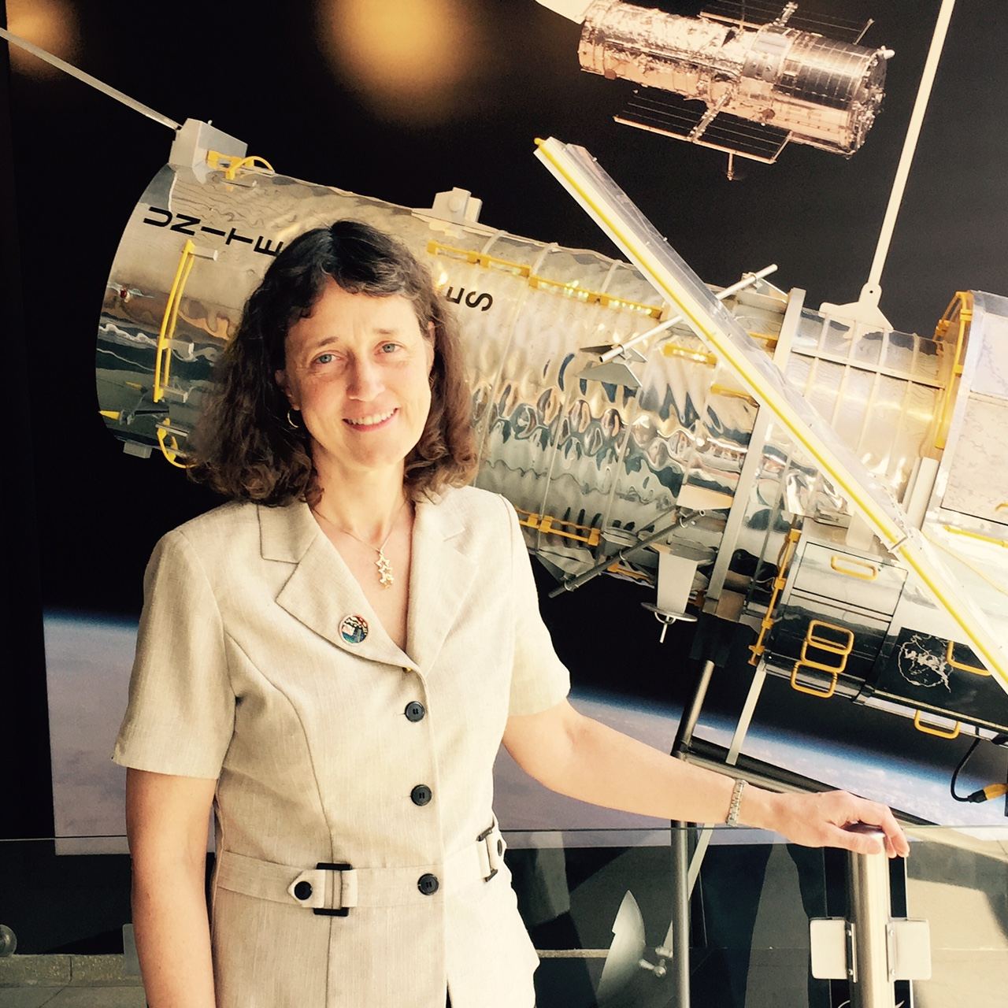
Creation and science: conflicting or complementary?
Dr Jennifer Wiseman – Are science and Faith in conflict?
Dr. Jennifer Wiseman grew up on a farm in the Ozark mountains of Arkansas, where she learned to appreciate the night sky and the natural world. She received a PhD in astronomy from Harvard University, followed by research in star formation as a Jansky Fellow at the National Radio Astronomy Observatory and as a Hubble Fellow at the Johns Hopkins University. She later served as the Program Scientist for the Hubble Space Telescope at NASA Headquarters, and then for several years headed the Laboratory for Exoplanets and Stellar Astrophysics at NASA's Goddard Space Flight Center, where she is now the Senior Project Scientist for the Hubble Space Telescope.
For more videos:
http://www.testoffaith.com/resources/resources.aspx?resource=true&catid=13&id=156

Slide 9
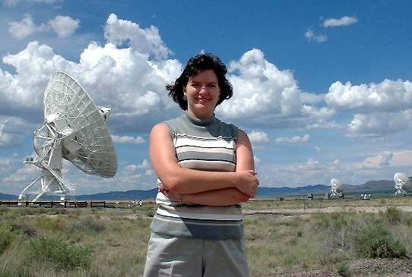
Creation and science: conflicting or complementary?
Dr Deborah Haarsma – Do we have to choose science without God, or God without science?
Dr Deborah Haarsma is Associate Professor in the Department of Physics and Astronomy at Calvin College in Grand Rapids. She studied both physics and music as an undergraduate and received a Bachelor of Science in Physics and a Bachelor of Music in Piano Performance. This was followed by a PhD in astrophysics at the Massachusetts Institute of Technology. Her current research is on galaxy formation and galaxy clusters.
For more videos:
http://www.testoffaith.com/resources/resources.aspx?resource=true&catid=13&id=156

Slide 10
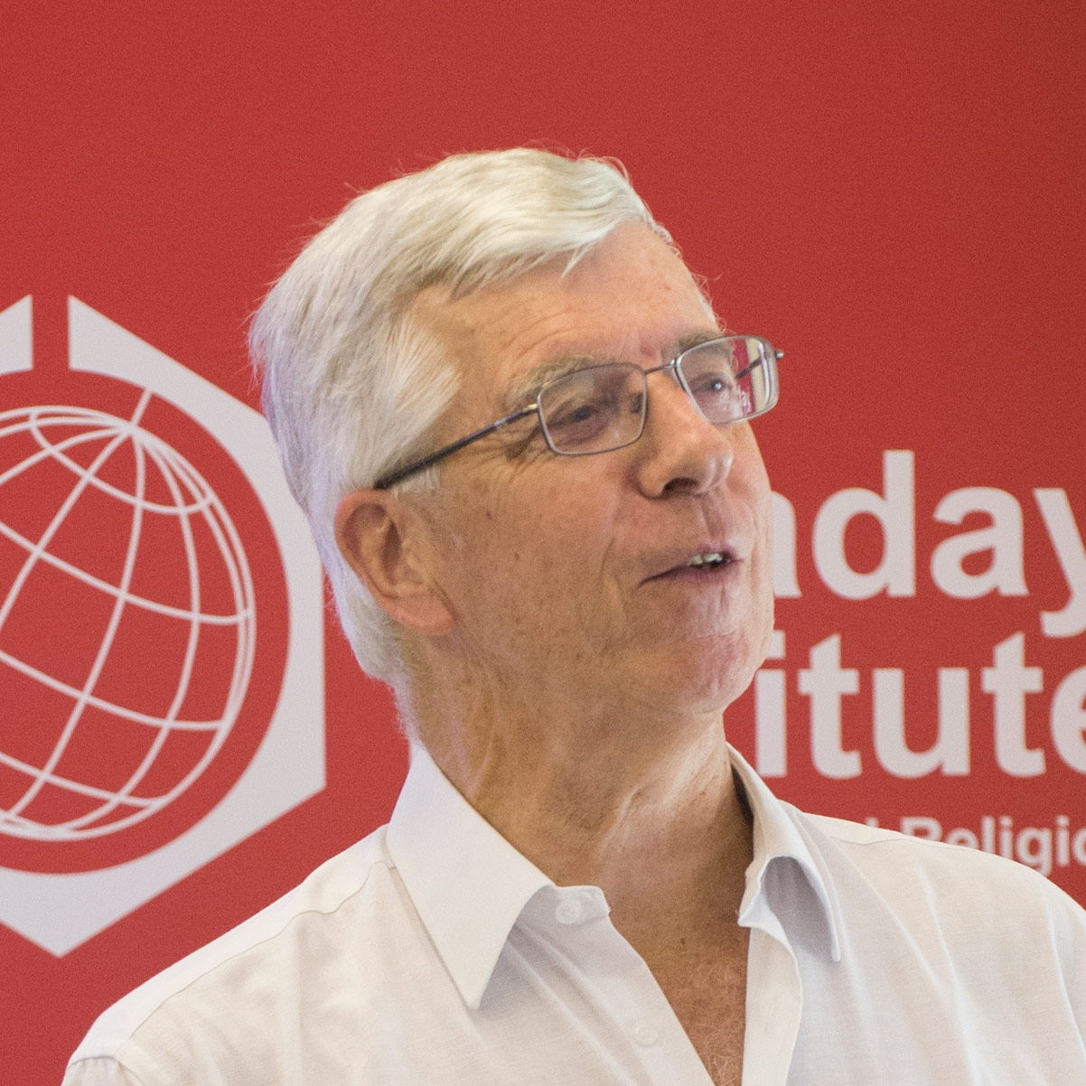
Creation and science: conflicting or complementary?
Dennis Alexander - How do you reconcile the timescale of evolution with Genesis?
Dr Denis Alexander is the director of the Faraday Institute for Science and Religion at St Edmund’s College, Cambridge, and is a popular writer and speaker on science and faith. His latest book is called Creation or Evolution: Do We Have to Choose? He is editor of the journal Science & Christian Belief and is on the National Committee of Christians in Science.
For more videos:
http://www.testoffaith.com/resources/resources.aspx?resource=true&catid=13&id=156

Slide 12
Can you compose a question to ask a scientist who may also be a Christian?
Were any of your questions answered today?
For more videos:
http://www.testoffaith.com/resources/resources.aspx?resource=true&catid=13&id=156
Notes:
Answers and discussion from class answers from last lesson

Slide 13
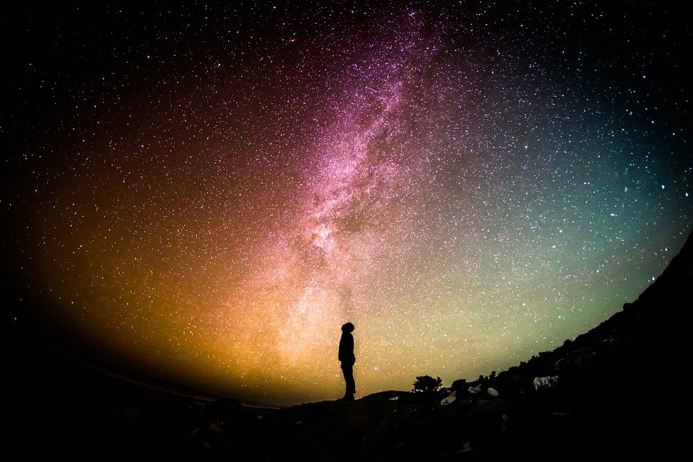
Home learning - Gaze up at the night sky and write down your feelings and sensations.

Slide 14
What and how did you learn?
What I have learnt today? - One sentence or phrase
How I felt about my learning:
Red – low understanding
Orange – understood some but not all
Green – understood all
A question related to the lesson – optional

