Slide 1
Can you name five fruits or vegetables that begin with the letter ‘a’?

Slide 3
This Photo by Unknown Author is licensed under CC BY-NC

Slide 4
This Photo by Unknown Author is licensed under CC BY-SA-NC

Slide 5
This Photo by Unknown Author is licensed under CC BY-SA

Slide 6
This Photo by Unknown Author is licensed under CC BY-NC-ND

Slide 7
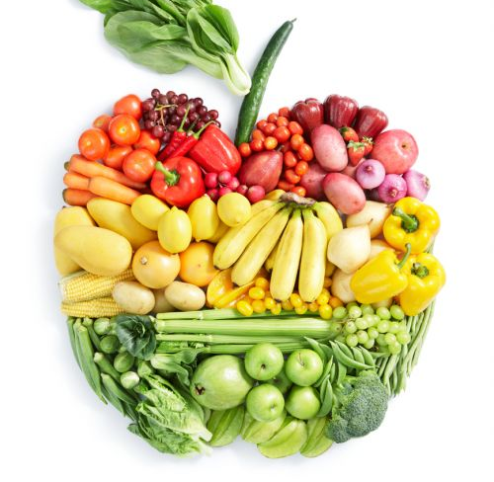
Healthy diet…

Slide 8
This week is Mental Health Awareness Week

Slide 10
‘Love your neighbour.’ (The Bible)
‘By the morning brightness. And by the night when it is stillest. Your Lord has not forsaken you.’ (The Qur’an)
Prayer

Slide 11
Be a good steward of your physical body!
‘Your body is a temple of the Holy Spirit.’ (The Bible)

Slide 12
Buddhist practices of mindfulness and meditation
Contemplation and practice of thanksgiving prayer

Slide 13
Be a good steward of your intelligence!
Jewish tradition of learning a section of the Torah for bar/bat mitzvah

Slide 14
Langar meal
Charity
Help those in need

Slide 15
Let us pray….
Dear God,
We pray that today we might experience a sense of wellbeing and satisfaction about life.
We ask you to help us remember the practical things that we can do to support our own wellbeing.
We thank you for the ways in which both science and religion remind us of what works towards health and happiness.
Help us today to feel able to connect, be active, take notice, keep learning and give.
Amen

