Slide 1
Encouraging

Slide 2
Today, we are thinking about Jesus’ last meal before his death. This was an important moment for Jesus. Our focus is encouraging.
Before we start, consider these questions…
Are there times that you enjoy remembering things? Maybe you have important books, toys or photographs, that bring back special memories for you?​
What other things can trigger our memories?​
How can memories help us?

Slide 3
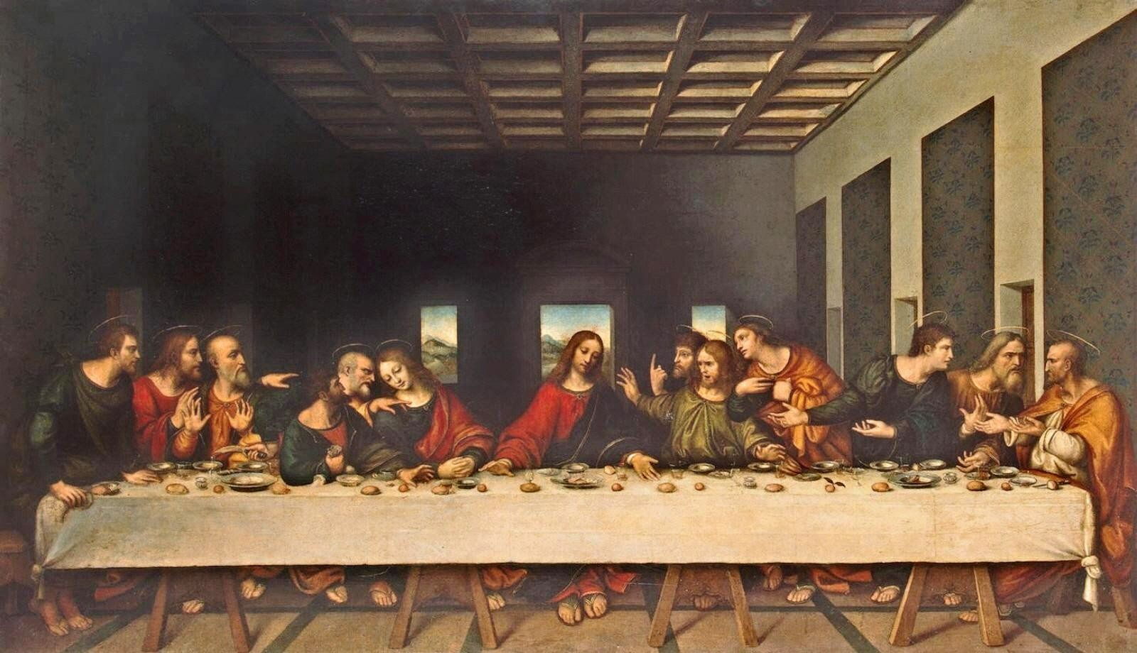
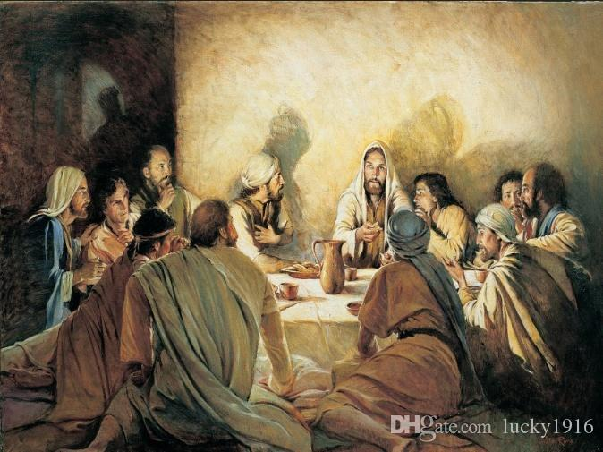
Look at these paintings based on the story.
One of the most famous paintings of The Last Supper is by Leonardo Da Vinci. He paints Jesus in the centre of the table with the disciples on either side.
The other picture shows Jesus and the disciples sitting in a circle.
Which painting do you prefer? How does each one make you feel?

Slide 4
Luke’s gospel tells us this part of the story.
Luke – Chapter 22
¹⁴ When the time came, Jesus and the apostles were sitting at the table. ¹⁵ He said to them, “I wanted very much to eat this Passover meal with you before I die. ¹⁶ I will never eat another Passover meal, until it is given its true meaning in the kingdom of God.”
¹⁷ Then Jesus took a cup. He gave thanks to God for it and said, “Take this cup and give it to everyone here. ¹⁸ I will not drink again from the fruit of the vine until God’s kingdom comes.”
¹⁹ Then Jesus took some bread. He thanked God for it, broke it, and gave it to the apostles. Then Jesus said, “This bread is my body that I am giving for you. Do this to remember me.” ²⁰ In the same way, after supper, Jesus took the cup and said, “This cup shows the new agreement that God makes with his people.
This new agreement begins with my blood which is poured out for you.”

Slide 5
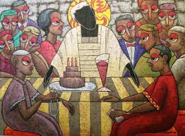
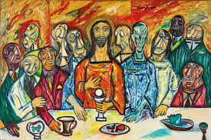
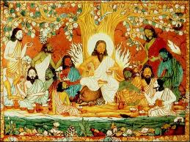
Artists all over the world have painted The Last Supper. Each picture shows it in a different style but…..
What do the pictures have in common?
What does this show us about what is important in them?

Slide 6
Jesus told his followers to copy his celebration of the last supper, to help them remember what he had done for them. He knew remembering would encourage them to stay strong in their walk of faith. To this day, every week, all over the world, Christians come together to have a sip of wine and eat a small piece of bread, to remind them of this last meal and the sacrifice Jesus made on the cross.
Remembering things can give us encouragement too. We can remember successes we have had, things we have learnt from and the example of those we look up to.

Slide 7
Think about all the success you’ve had this week and all the things you have learned. Can you encourage yourself by saying, ‘Well done! You did great!!’ Maybe you could make a certificate for yourself.
or
Just like Jesus encouraged his disciples its good for us to encourage each other. Today write a thank you note or card for a friend or family member to encourage them.

Slide 8
Lord Jesus, just as you encouraged your disciples in their faith, help me encourage my friends and family by finding time to show my appreciation for everything they do. Amen

Slide 9
This resource was produced by the Diocese of Leeds Education Team. For more information about this or future resources,
please contact your named adviser:
simone.bennett@leeds.anglican.org
simon.sloan@leeds.anglican.org
darren.dudman@leeds.anglican.org
janet.tringham@leeds.anglican.org
lee.talbot@leeds.anglican.org
rupert.madeley@leeds.anglican.org

