Slide 1
Sharing

Slide 2
Today we are going to begin to consider the climax of the Easter story, Jesus’ death and resurrection. Our focus today is sharing.
Before we start, consider these questions:
What do you think the phrase “To do whatever it takes” means?
When would that attitude be a good thing or a bad thing?

Slide 3
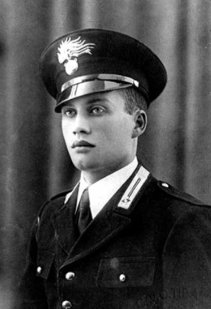
Have a look at this picture. What does it show you about the man represented?
The picture is of Salvo D’Acquisto, an Italian policeman, during World War Two.
Click here to listen to his story
Why do you think Salvo did what he did?
How do you think the 22 men felt about his actions?
Do you think you would have had the courage to do what he did?

Slide 4
Today we read about Jesus giving up his life.
John - Chapter 19
¹⁷ Carrying his own cross, Jesus went out to a place called The Place of the Skull. (In the Jewish language this place is called Golgotha.) ¹⁸ There they nailed Jesus to the cross…
²⁸ After this, Jesus knew that everything had been done. To make the Scripture come true, he said, “I am thirsty.” ²⁹ There was a jar full of vinegar there, so the soldiers soaked a sponge in it. Then they put the sponge on a branch of a hyssop plant and lifted it to Jesus’ mouth. ³⁰ Jesus tasted the vinegar. Then he said, “It is finished.” He bowed his head and died.

Slide 5
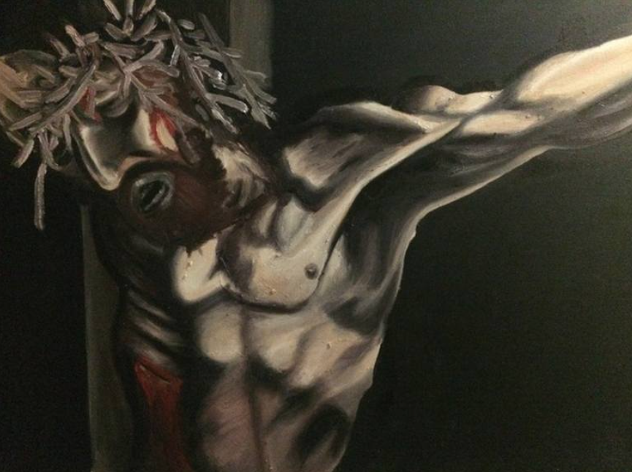
Dying on a cross in Roman times was a horrible way to die.
The Romans used death on a cross to punish criminals and wrong doers. Jesus hadn’t done anything wrong so why do you think he let this terrible thing happen to him?
Crucifixion by Walter Gordon
What do you think are the similarities between Jesus’s death and that of Salvo D’Acquisto? And the differences?

Slide 6
Christians believe that Jesus was the Son of God. Even though he had done nothing wrong, he allowed himself to be punished as if he had, so that mankind doesn’t have to be.
Like the story of Salvo D’Aquisto, he gave himself to save other people but, in the case of Jesus, it was God’s son that was making the sacrifice and it was the whole of humanity he was saving.
It is very unlikely that we will ever need to make the same sacrifice for other people as we have heard about today. We can, however, share our lives with people in other ways, sacrificing our time, our strength and our love to make other people’s lives better.

Slide 7
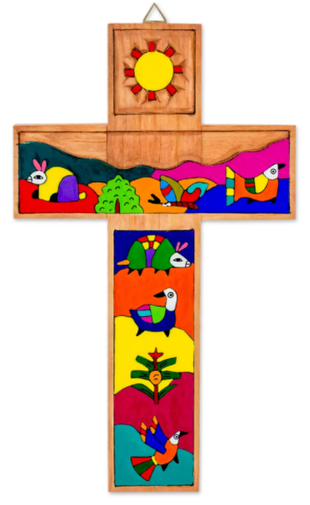
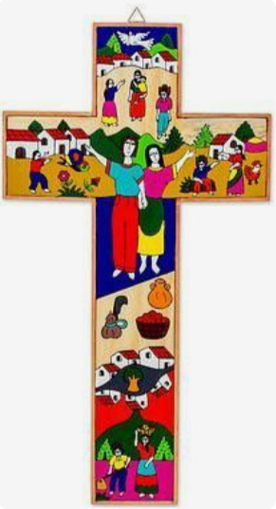
Think of something you don’t like doing but that would help someone. It might be washing up, tidying your bedroom or something else. Make this sacrifice today.
Or
Draw a Salvadoran cross, decorated with pictures from your own life.

Slide 8
Lord Jesus, thank you that you didn’t share our punishment, but instead took it all on yourself to bring us to God. Help us to share what we have, our time, wealth, energy and love to help those around us. Amen

Slide 9
This resource was produced by the Diocese of Leeds Education Team. For more information about this or future resources,
please contact your named adviser:
simone.bennett@leeds.anglican.org
simon.sloan@leeds.anglican.org
darren.dudman@leeds.anglican.org
janet.tringham@leeds.anglican.org
lee.talbot@leeds.anglican.org
rupert.madeley@leeds.anglican.org

