Slide 1
The Rhythm of Life Advent Journey
Resting
Advent – Day 1

Slide 2
Have a thoughtful look at these images.
Where would your ideal ‘home’ be?
What would it be like?

Slide 3
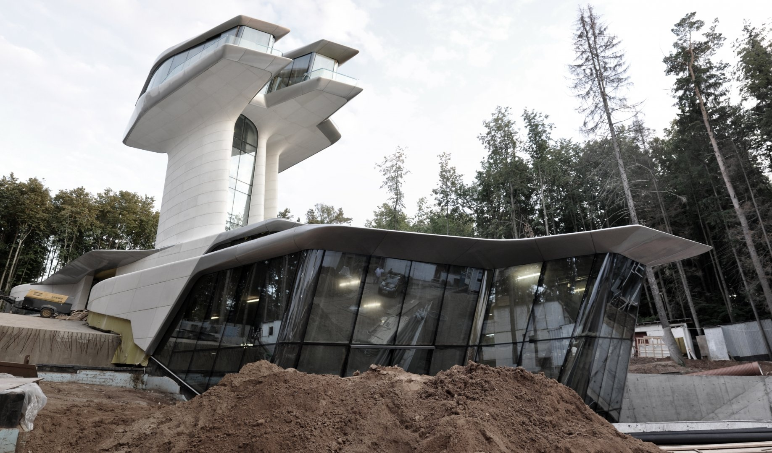
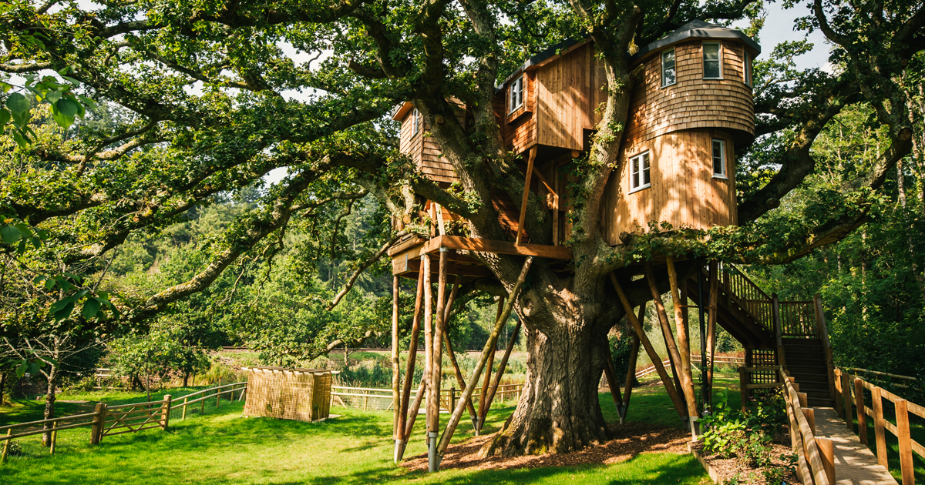
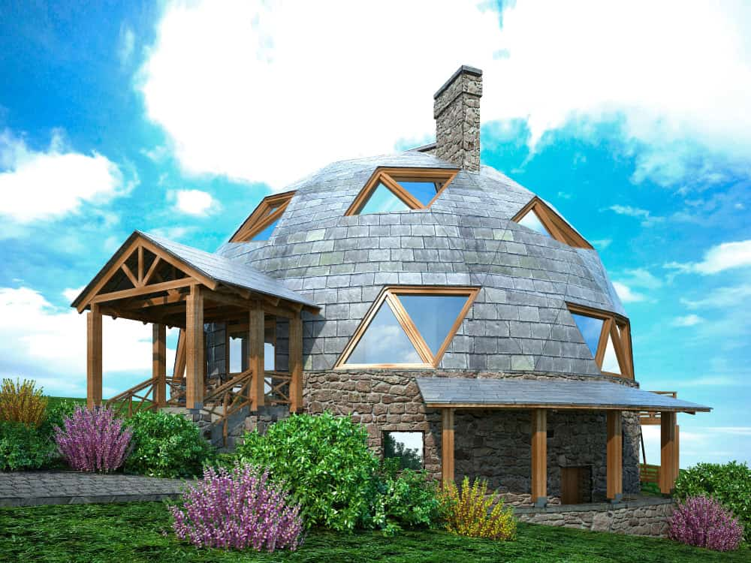
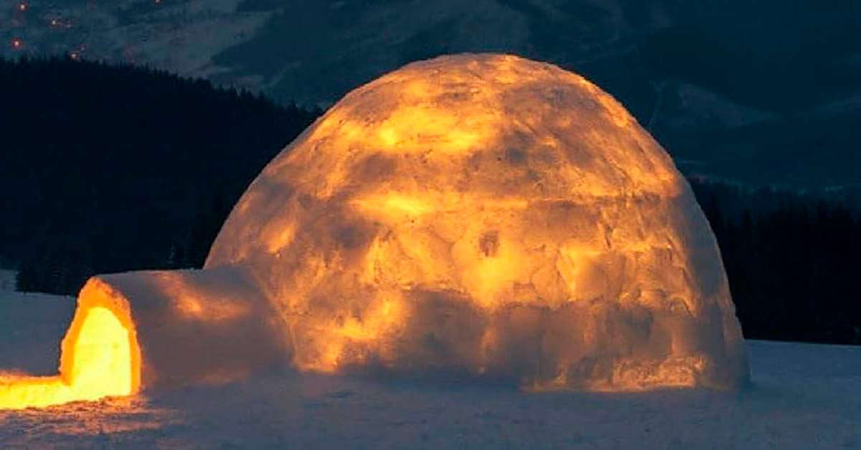
What would your ideal ‘home’ be like?

Slide 4
What would your ideal ‘home’ be like?
Like these? Or something completely different?
What would you see, hear and smell?
How would you feel there?
Do you feel that way at any other time?

Slide 5
A thought to take away…
A place of rest is a place where we can feel at peace. This might be a special place, or it might be a sense of peace that we carry with us through the day.
Time spent resting is time well spent. It could be thirty seconds or it could be an hour. The important thing is to make time to give your body and your mind the time to relax, restore and revive. By doing this, you will enrich your mind and your spirit. Learning how to do this well is a wonderful skill that will benefit you throughout your life.

Slide 6
Today’s Challenge
If you would like to join in with today’s challenge, why don’t you:
Make up your mind to have moments to rest during the day. Make a timetable for these. Can you stick to it?
or
Draw a design of your ideal ‘rest pod’ or build a model of it in a shoebox.

Slide 7
If you would like to, you can join in saying these prayers.
A Prayer for the Day
The Rhythm of Life Prayer
Lord Jesus,
Prince of Peace,
give us your peace
so that we can feel at rest
even in the busyness of life,
even in the face of difficulties.
Amen
Loving God,
Help us to learn from you
the habit of resting,
so that the rhythm of our lives can match
the rhythm of your heart of love.
Amen

Slide 8
This resource was produced by the Diocese of Leeds Education Team.
For more information about this or future resources,
please contact your named adviser:
simone.bennett@leeds.anglican.org
simon.sloan@leeds.anglican.org
darren.dudman@leeds.anglican.org
janet.tringham@leeds.anglican.org
lee.talbot@leeds.anglican.org
rupert.madeley@leeds.anglican.org

