Slide 1
Praying

Slide 2
Today, we will be looking at praying. We are thinking about what Jesus was doing in the wilderness for forty days. Sometimes people use the word ‘desert’ instead of wilderness. Wilderness means somewhere wild and without people, a place that is not easy to live in!
Before we start, consider these questions…
Where do you go when you need to think or you need some time to be quiet and on your own?
How do you prepare for things? For example, going out, getting ready for school or getting ready for a visitor. What things do you need to do to be ready?

Slide 3
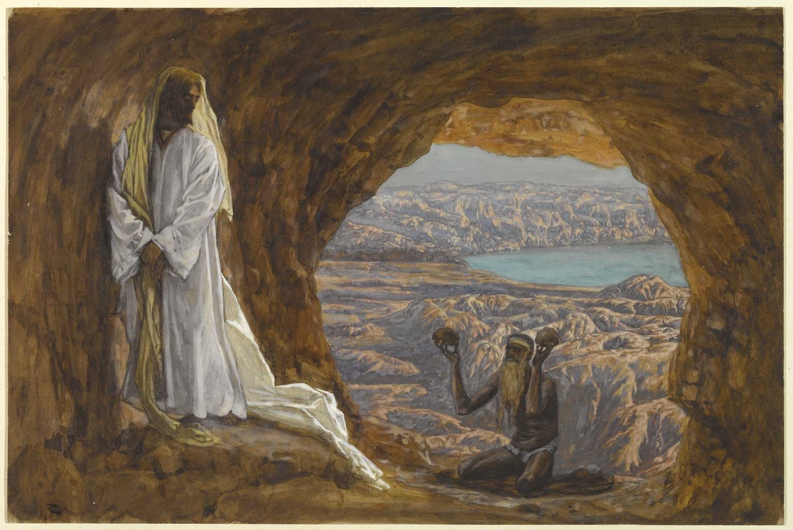
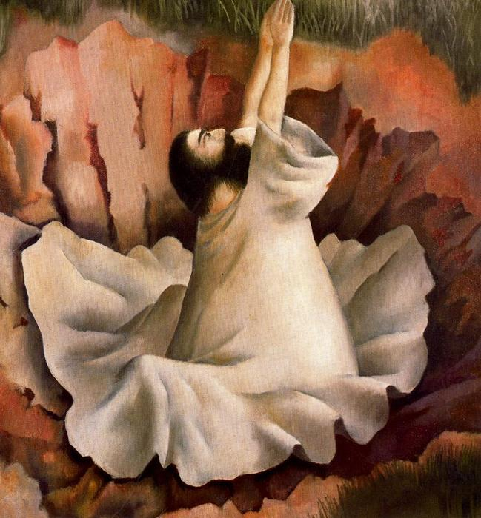
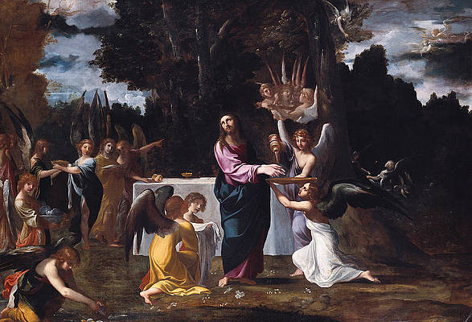
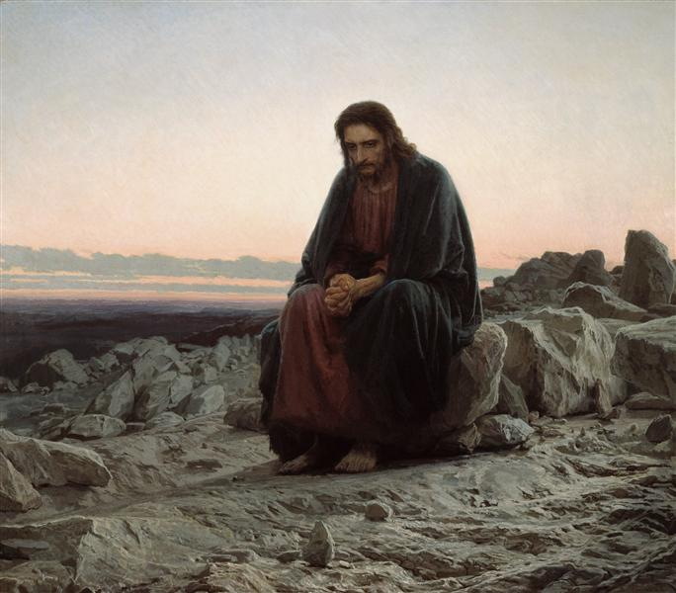
Look at these paintings based on the story.
What is the same or different about them?
How might Jesus be feeling in each of the pictures?

Slide 4
Mark’s gospel tells us this part of the story.
Mark – Chapter 1
¹² Then the Spirit sent Jesus into the desert alone. ¹³ He was in the desert for 40 days and was there with the wild animals.

Slide 5
Why do you think Jesus decided to be alone in the wilderness for such a long time?
What do you think he was doing all this time?
How would it have prepared him for what was to come next?

Slide 6
The Bible tells us that whenever Jesus was alone, he spent time praying to God. In fact, he made sure he had these special times, like in our story today. Being alone with God helped him to be prepared and get ready for the important things he was going to do.
Christians believe that prayer is an important part of life. Praying to God can help to think about important things, ask for help and support, say thank you or tell God about the things that cause worry. It can help people prepare for whatever they have to face in life. Prayer means no one is ever alone.

Slide 7
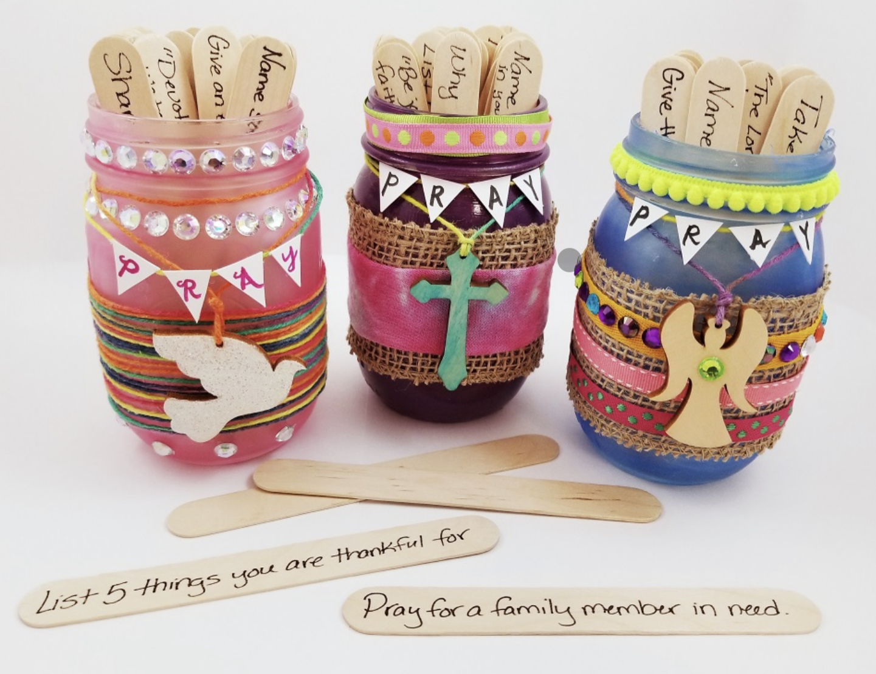
Start your day by having some time to yourself to talk to God. You could say what you’re looking forward to or what you’re worried about and ask for help with the things you have to do.
or
Make your own prayer jar! You can wrap different materials around and write your prayers on lollipop sticks or card strips.

Slide 8
Heavenly Father, just like Jesus in the wilderness, help me to know you are there for me, listening to my prayers and helping me to prepare for all of the things I have to do. Amen

Slide 9
This resource was produced by the Diocese of Leeds Education Team. For more information about this or future resources,
please contact your named adviser:
simone.bennett@leeds.anglican.org
simon.sloan@leeds.anglican.org
darren.dudman@leeds.anglican.org
janet.tringham@leeds.anglican.org
lee.talbot@leeds.anglican.org
rupert.madeley@leeds.anglican.org

