Slide 1
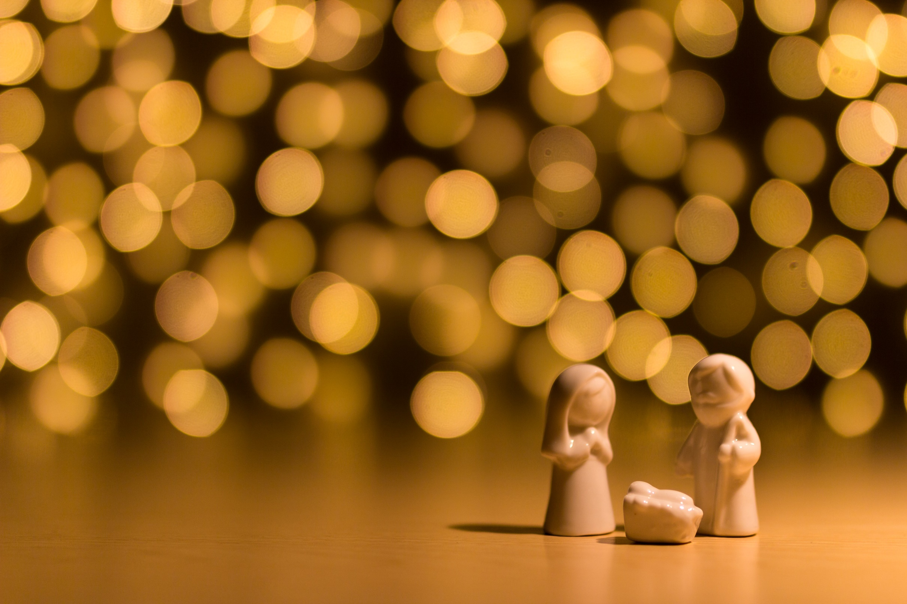
The Rhythm of Life Advent Journey
Celebrating

Slide 2
Celebration 1
Have a thoughtful look at these images.
What do they have in common?

Slide 3
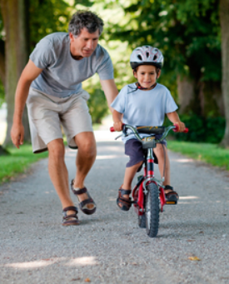
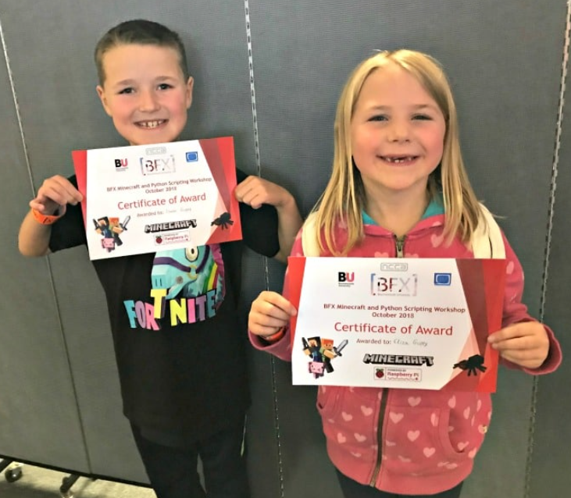
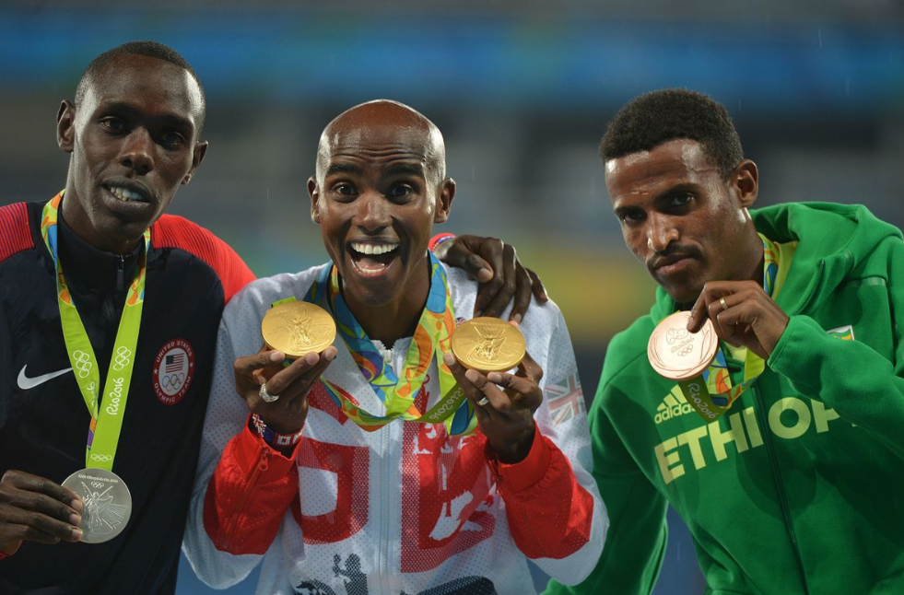
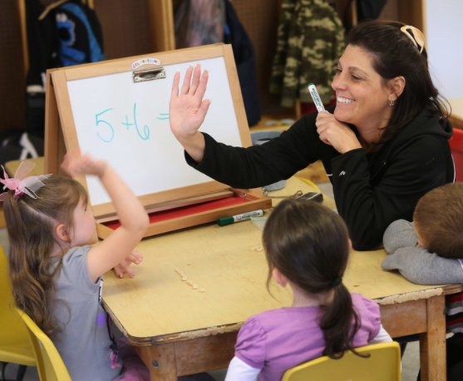
Celebration 1
What do these images have in common?

Slide 4
Celebration 1
Celebration
What can you celebrate each day?
Which of these are important and why?

Slide 5
Celebration 1
A thought to take away…
It doesn’t matter how big or small your achievements might seem to others, they are still things you can celebrate. You can also celebrate many other things in life, such as good things that happen to you or the kindness shown you by other people. Learning the habit of celebrating brings joy to your life and can help you keep positive, even when things are tough.

Slide 6
Celebration 1
Today’s Challenge
If you would like to join in with today’s challenge,
why don’t you:
Spend a few moments at the end of the day thinking of all the things you could celebrate in your day.
or
Make yourself a certificate to celebrate something from your day.

Slide 7
If you would like to, you can join in saying these prayers.
A Prayer for the Day
The Rhythm of Life Prayer
Holy Spirit,
You are the source of joy, overflowing like a fountain.
Help us to notice and joyfully celebrate achievements
both great and small,
both our own and other people’s,
each and every day.
Amen
Loving God,
Help us to learn from you
the habit of celebrating,
so that the rhythm of our lives can match
the rhythm of your heart of love.
Amen

Slide 8
This resource was produced by the Diocese of Leeds Education Team.
For more information about this or future resources,
please contact your named adviser:
simone.bennett@leeds.anglican.org
simon.sloan@leeds.anglican.org
darren.dudman@leeds.anglican.org
janet.tringham@leeds.anglican.org
lee.talbot@leeds.anglican.org
rupert.madeley@leeds.anglican.org

